Slide 1
Universal Design
A Strategy for Aging well

Slide 2
Universal Design
The design of products and environments to be usable by all people to the greatest extent possible, without the need for adaptation or specialized design. - Ron Mace, NCSU
Human Centered Design
Inclusive Design
Design for All

Slide 3
Universal Design
The UD process invites designers to go beyond building or access code compliance to create excellent human-centered design.
Not a standard or building code
Applied to private and public spaces, products

Slide 4
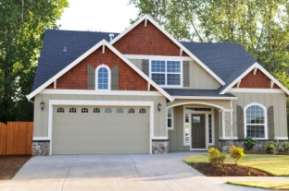
Universal Design Facilitates Aging in Place
The ability to live in one’s own home and community safely, independently, and comfortably, regardless of age, income or ability level.
Centers for Disease Control (CDC)

Slide 5
Seven Principles of Universal Design
Equitable Use
Flexibility in Use
Simple and Intuitive Use
Notes:
Equitable Use

Slide 6
Seven Principles of Universal Design
-Perceptible Information
- Tolerance for Error
- Low Physical Effort
- Size and Space for Approach and Use
Notes:
Equitable Use

Slide 7
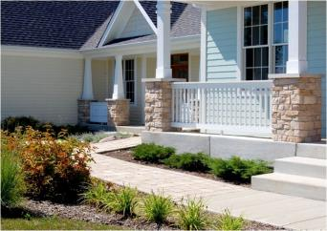
Top 12 Universal Design Features
No step entry
Wider doorways and hallways
Walk-in, no-threshold shower
A bedroom and bathroom on first floor
Reachable, rocker-type light switches
Lever-style door handles and faucets
AARP Guide to Revitalizing Your Home

Slide 8
Top 12 Universal Design Features, cont.
7. Kitchen appliances with auto shut-off
8. Non-slip flooring – kitchen and bath
9. Abundant, multi-source lighting
10. Grab bars in bathing areas
11. Comfortable furniture and furnishings
12. Telephones, doorbells with low frequency tones.
AARP Guide to Revitalizing Your Home

Slide 9
A starting Point
Think of Universal Design as a starting point
Just as ADA started the conversion and development of more accessible public spaces 25₊ years ago, creating Universally designed homes begins the process in housing stock.
If every new space designed incorporates UD, eventually houses will be improved for a full range of owners, buyers.

Slide 10
Seeing Universal Design
Planners and designers are in a unique position to facilitate positive change in how effectively home environments work for residents of all ages and abilities
Each room design, finish and product selection is an opportunity to improve usability

Slide 11
Universal Design in New Construction

Slide 12
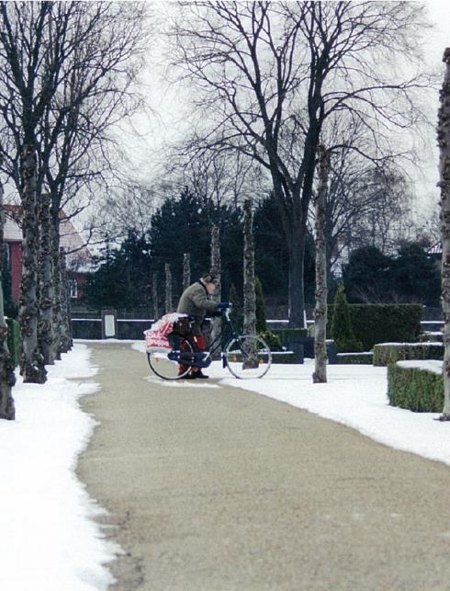
“I’m the result of being raised with my grandparents in my home. I saw my grandparents over the course of their lives…. And I realized in a quite young age that there was nothing wrong with my grandma. She wasn’t broken. But the tools we gave her were inadequate.
If we take choice away from consumers, we have failed them by design. Because it is only with choice that we have control over the quality of our lives.”
Patricia Moore - American industrial designer, gerontologist, and author.

Slide 13
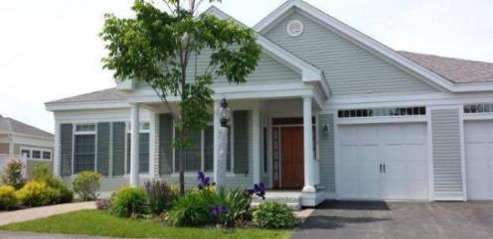
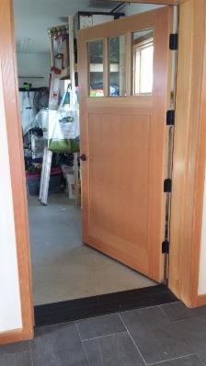
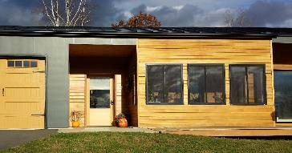
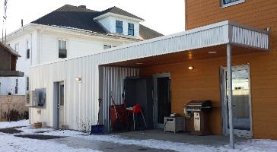
ENTRIES
Landscape walkways in place of traditional ramps
Opportunity to incorporate garden beds
Enables everyone to take the same route including carts, strollers, wagons
Maine Weather Protection
Glazing in door
Emergency Exit plan?

Slide 14
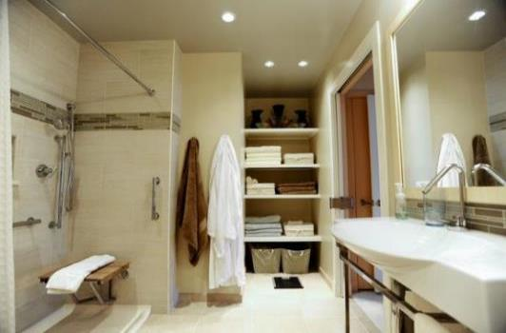
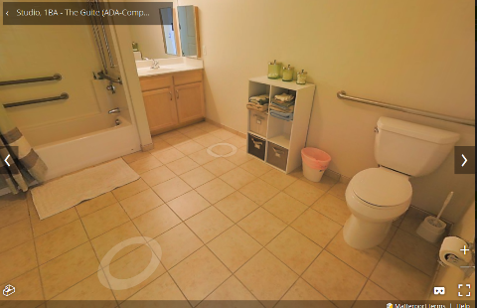
BATHROOMS
Full bathroom on main floor.
Reinforcement in walls for grab bars
Open floor space around one side of toilet
Slip resistant flooring
Lighting over shower/toilet/sink
Contrasting colors
Low or full height mirror
Mount medicine cabinet to side of sink

Slide 15
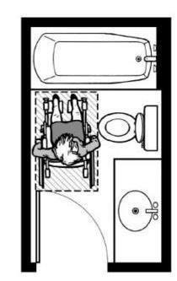
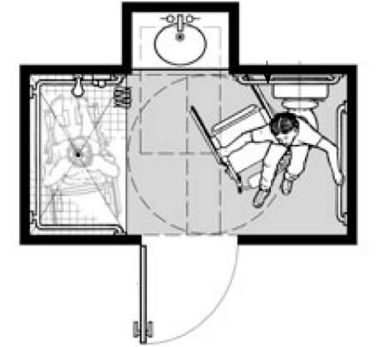
“Usable” vs. UNIVERSAL
From FHA Design Guide and Center for Universal Design

Slide 16
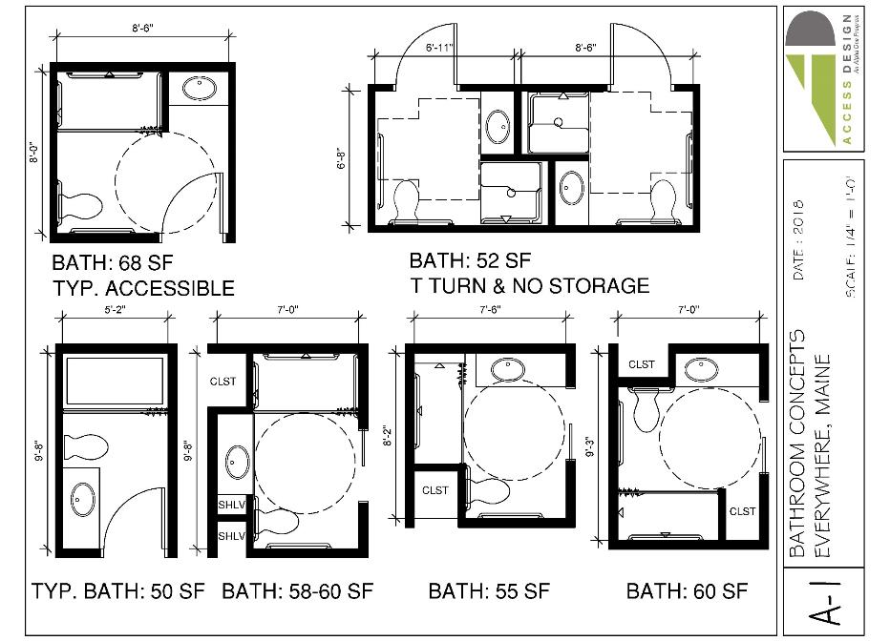
“Usable” vs. ACTUALLY USABLE
From FHA Design Guide

Slide 17
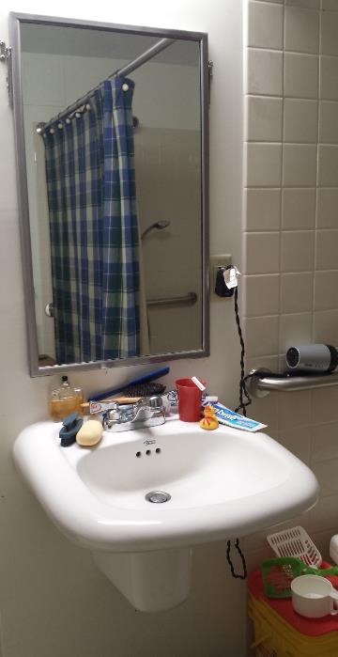
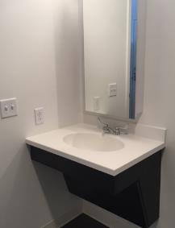
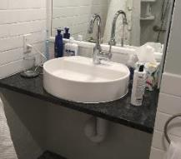
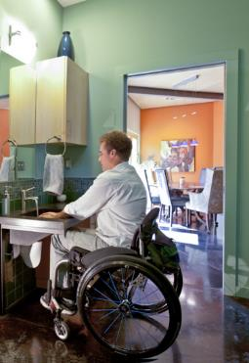
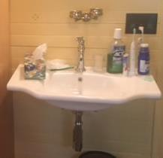
Equality/Flexibility
Not a public restroom, it is someone’s home that they use everyday

Slide 18
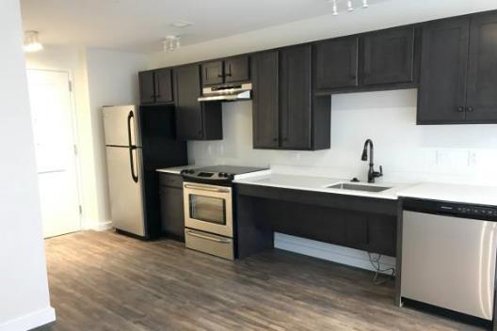
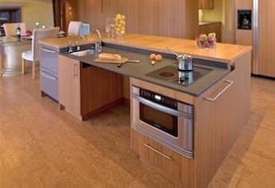
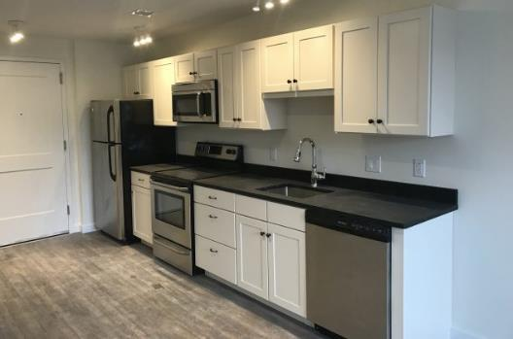
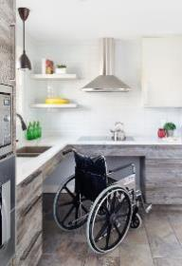
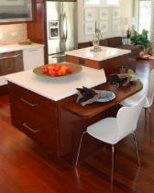
Equality/Flexibility
Senatore Architecture
MIKITEN ARCHITECTS
Senatore Architecture
Paragon Kitchens
LIFEHOUSE TM

Slide 19
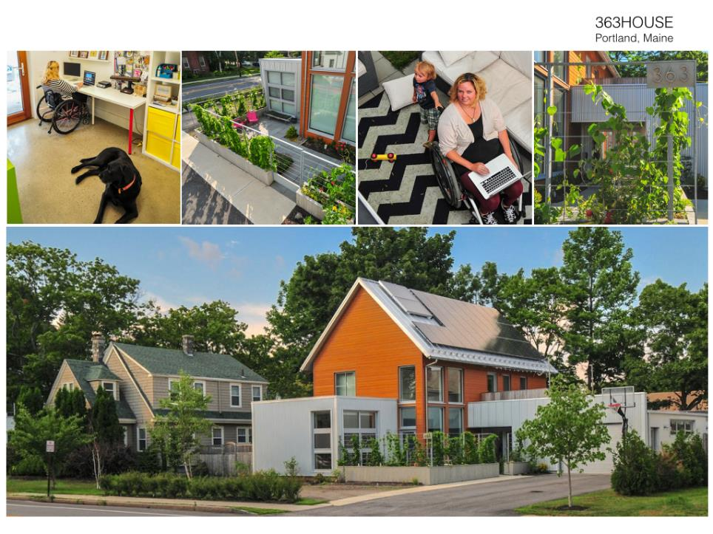
John Gordon Architect
http://aiamaine.me/project/363house/

Slide 20
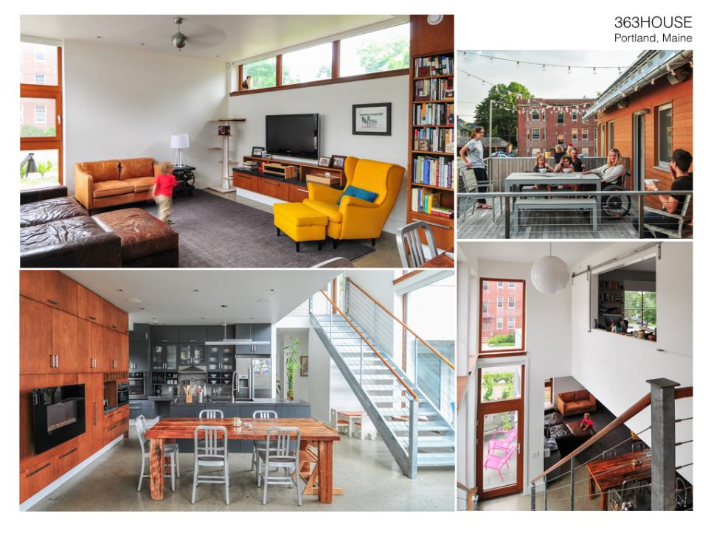
John Gordon Architect
http://aiamaine.me/project/363house/

Slide 21
John Gordon Architect

Slide 22
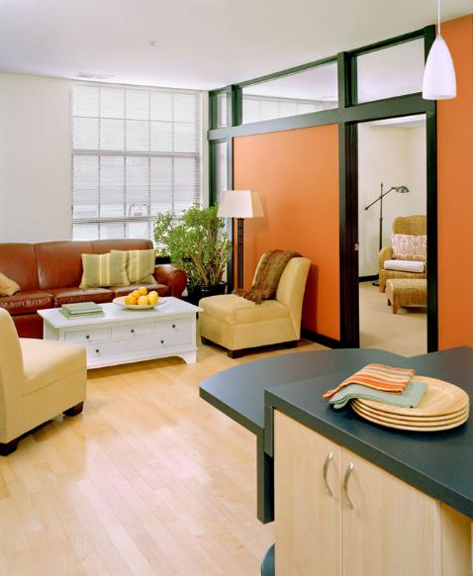
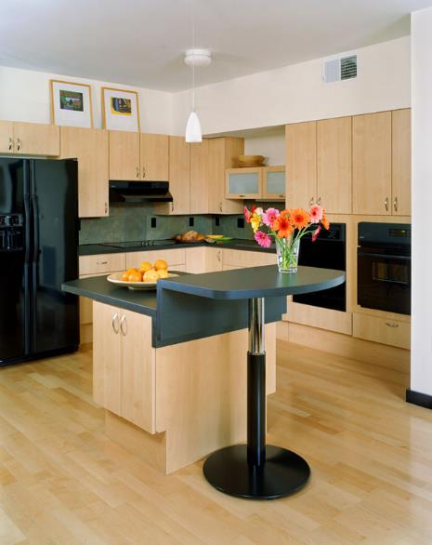
trivers.com
6northapts.com - St Louis 2006
1 bedroom starts at $1000

Slide 23
COST
(New Single Family Home)
2015 City of Davis, California: UD Ordinance
Door with a zero or low entry threshold = < $25
Interior path of travel throughout the ground floor = no additional cost
An accessible half bath may require additional space and result in an opportunity cost.
[Full bathroom with turning space: 10 SF x $200/SF = $2,000]
Grab bar backing (2x backing) at the toilet and shower is a negligible cost .
Electrical panel on the ground floor interior = $1,000-$3,000
Rocker light switches throughout = $50-$100 per house
Lever Hardware at Accessible Entrance and on Ground Floor = $50-$100
[TOTAL = $5,225+/-]

Slide 24
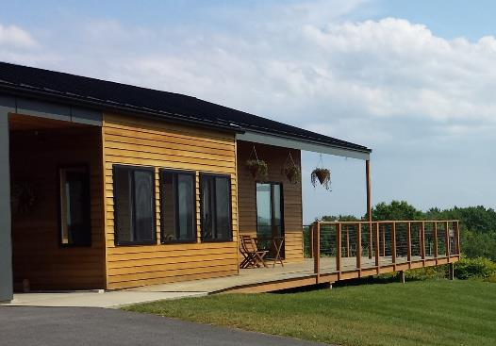
“I won’t give up. I’m not going anywhere until we get it right. Until we don’t have to talk about this. Until one day we don’t talk about accessible design or universal design or inclusive design.
We talk about design.”
Patricia Moore - American industrial designer, gerontologist, and author.

Slide 25
Universal Design in Renovations

Slide 26
Home for the Next 50 Years
The SalMen Residence, Takoma Park, Maryland

Slide 31
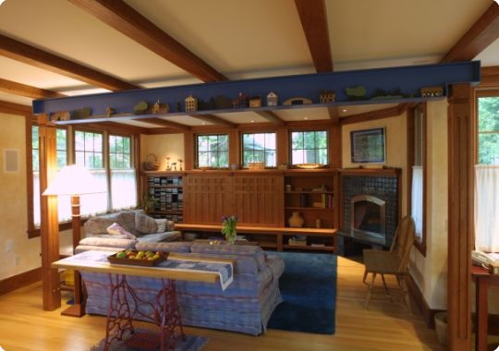

Slide 32
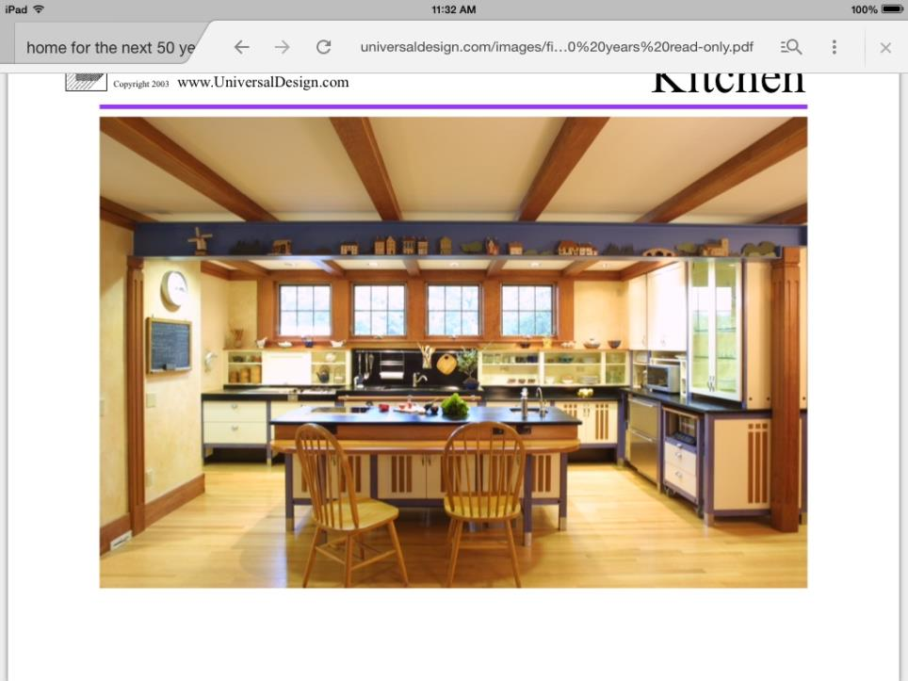

Slide 35
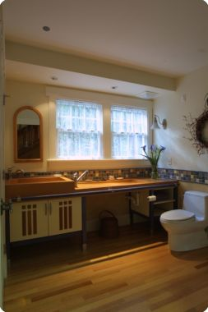

Slide 36
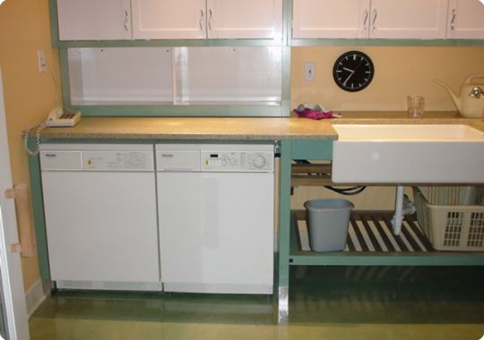

Slide 38
Contemplating Renovation
SEEING POTENTIAL IN EXISTING HOUSING STOCK

Slide 39
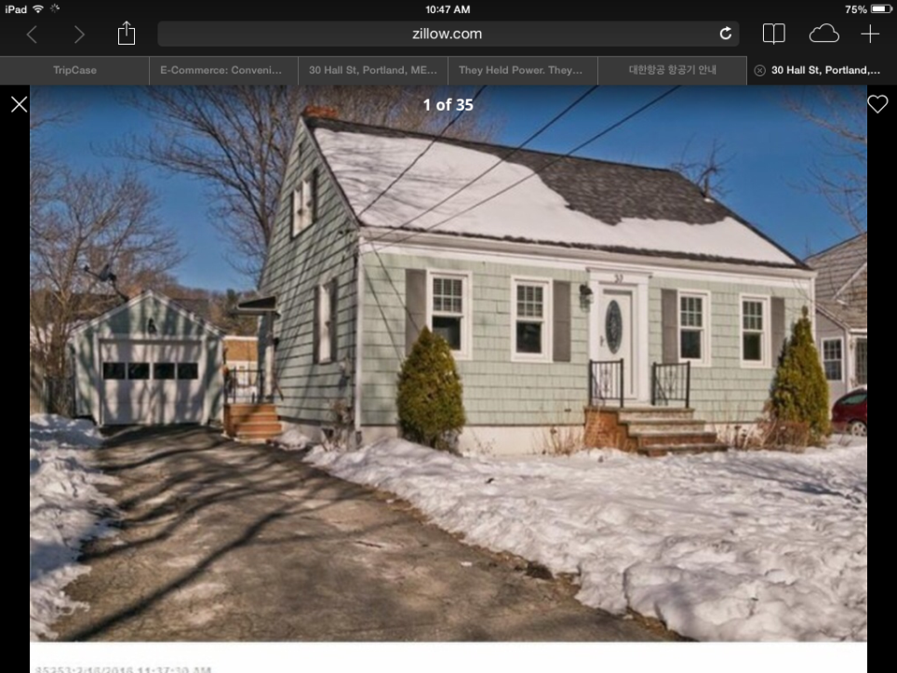

Slide 40
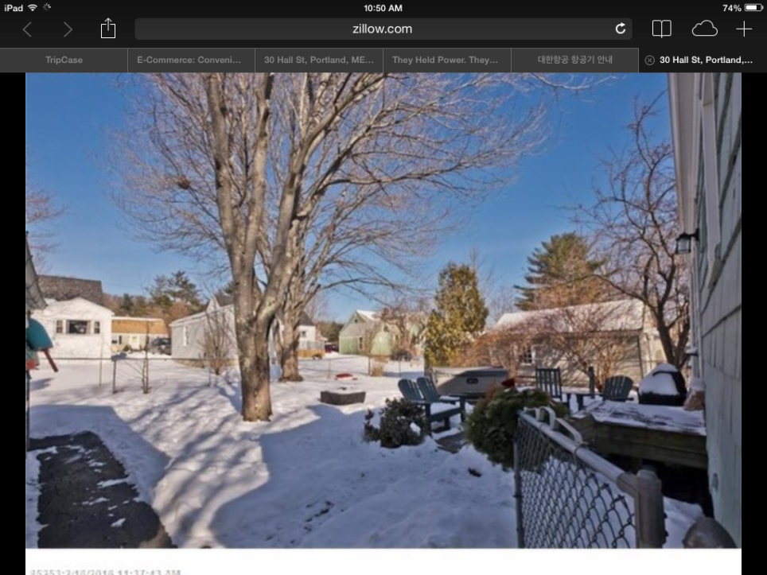

Slide 41
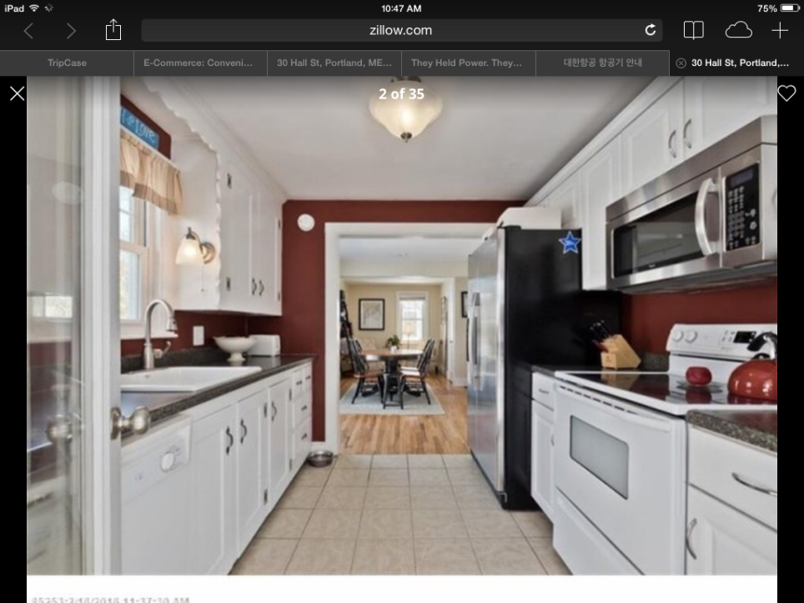

Slide 42
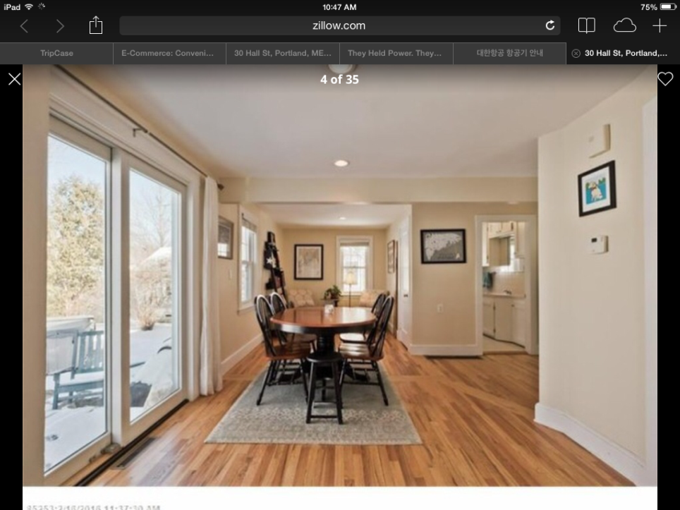

Slide 43
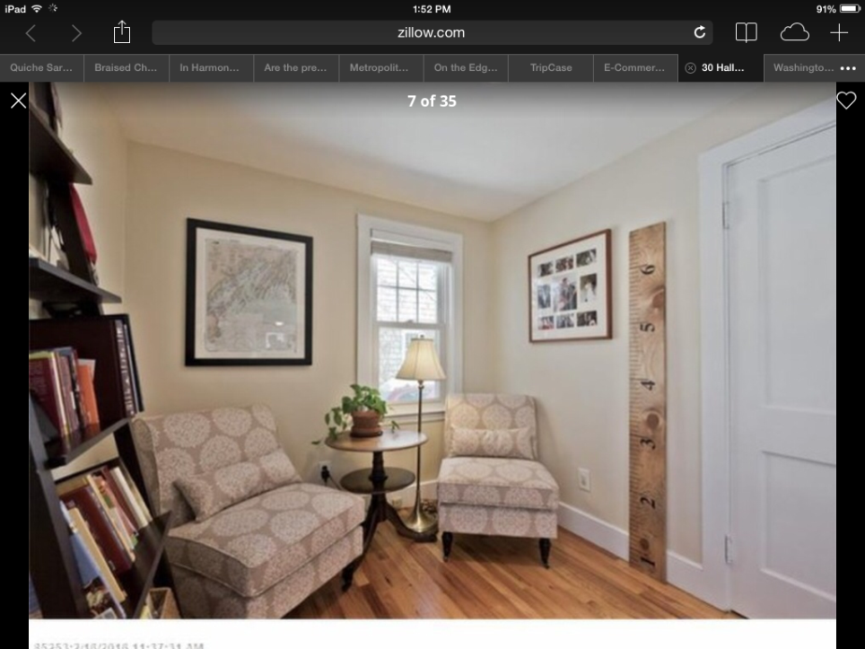

Slide 44
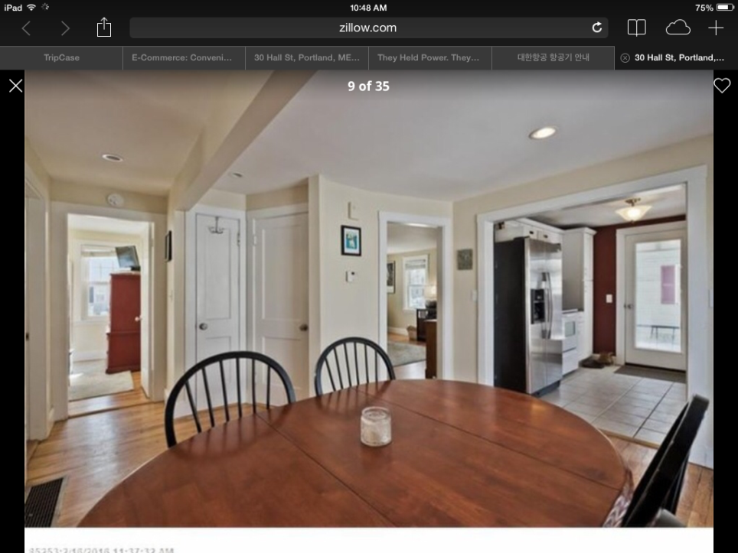

Slide 45
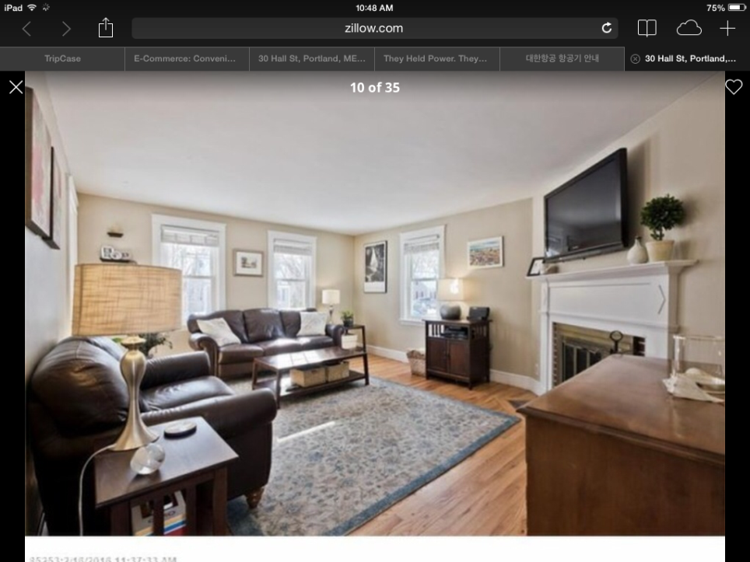

Slide 46
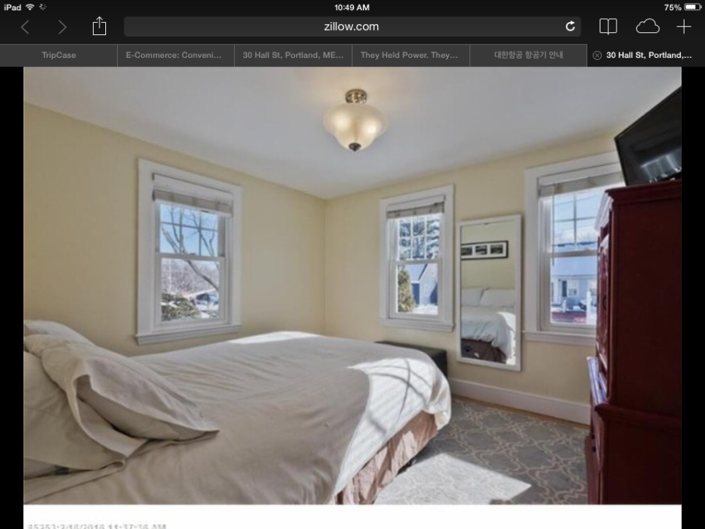

Slide 47
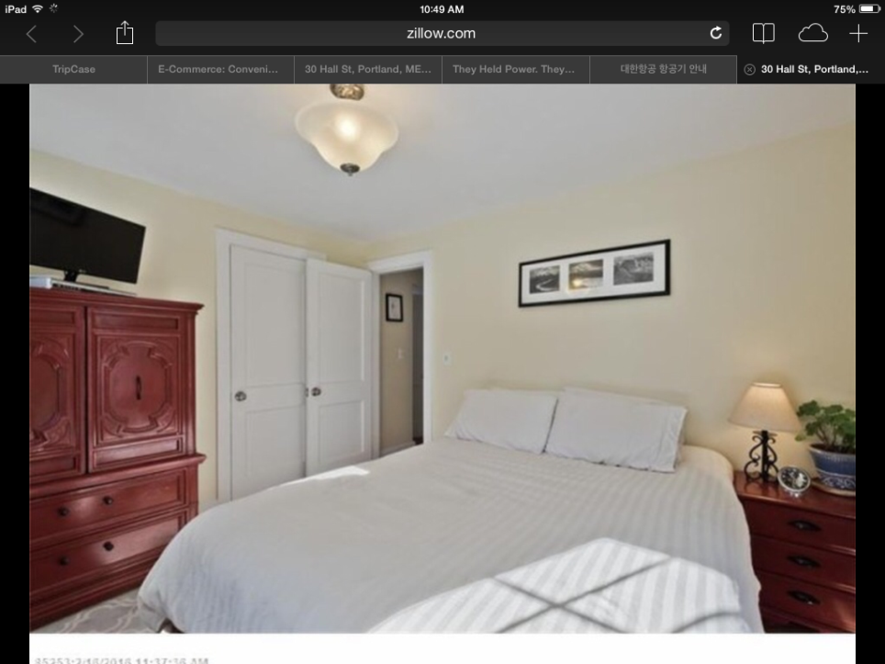

Slide 48
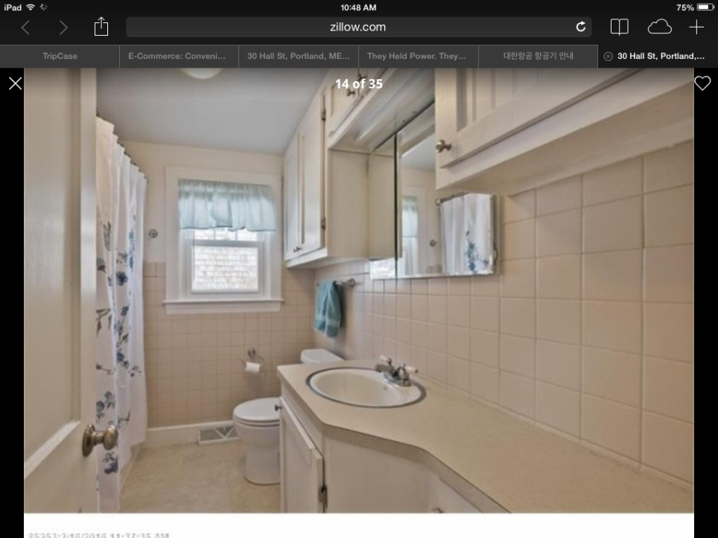

Slide 49
Thank you
Jill S. Johanning, AIA
Maine Licensed Architect
Alpha One/ Access Design
accessdesignme.org
207-619-9281
800-640-7200
Jennifer G. Eckel, MBA, CAPS
Tomorrow’s Spaces, LLC
tomorrowspaces.com
207- 450-7222

