Slide 1
Extend the time older Maine residents can stay safely in their homes…while improving health and safety outcomes.

Slide 2
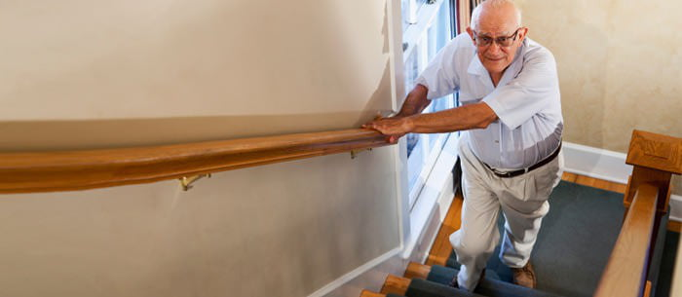
Three seasons ago I was skiing and now I’m living in my house which has become my entire world…the home modification team are my angels.

Slide 3
Comfort

Slide 4
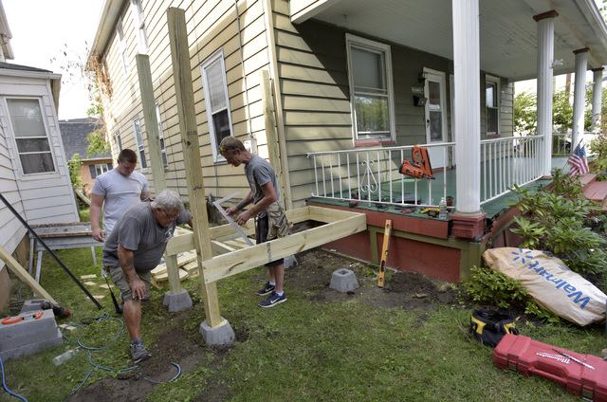
Can't tell you how much we appreciate all you and your team are doing for Mom.

Slide 5
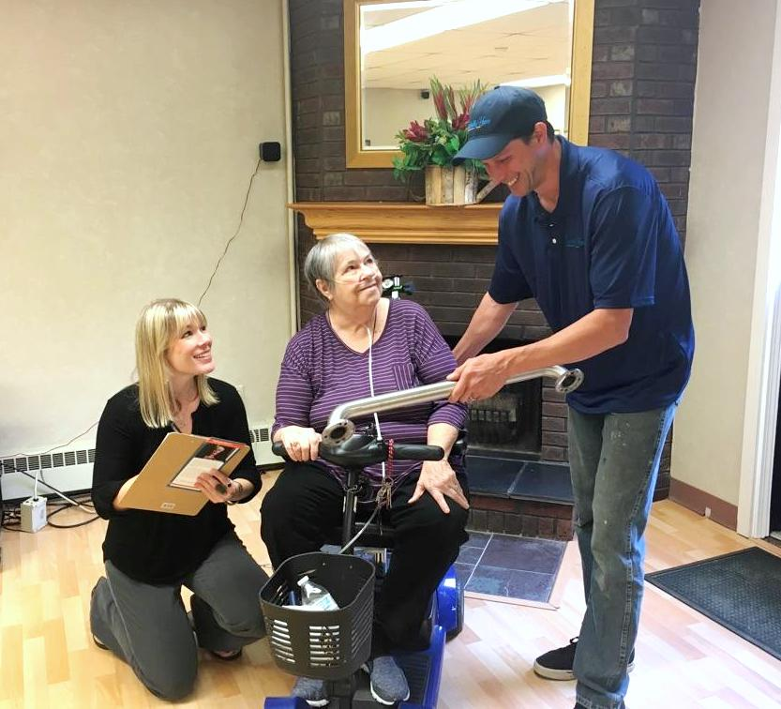
I have been so honored to have been selected for this help. This program is such a wonderful idea!

Slide 6
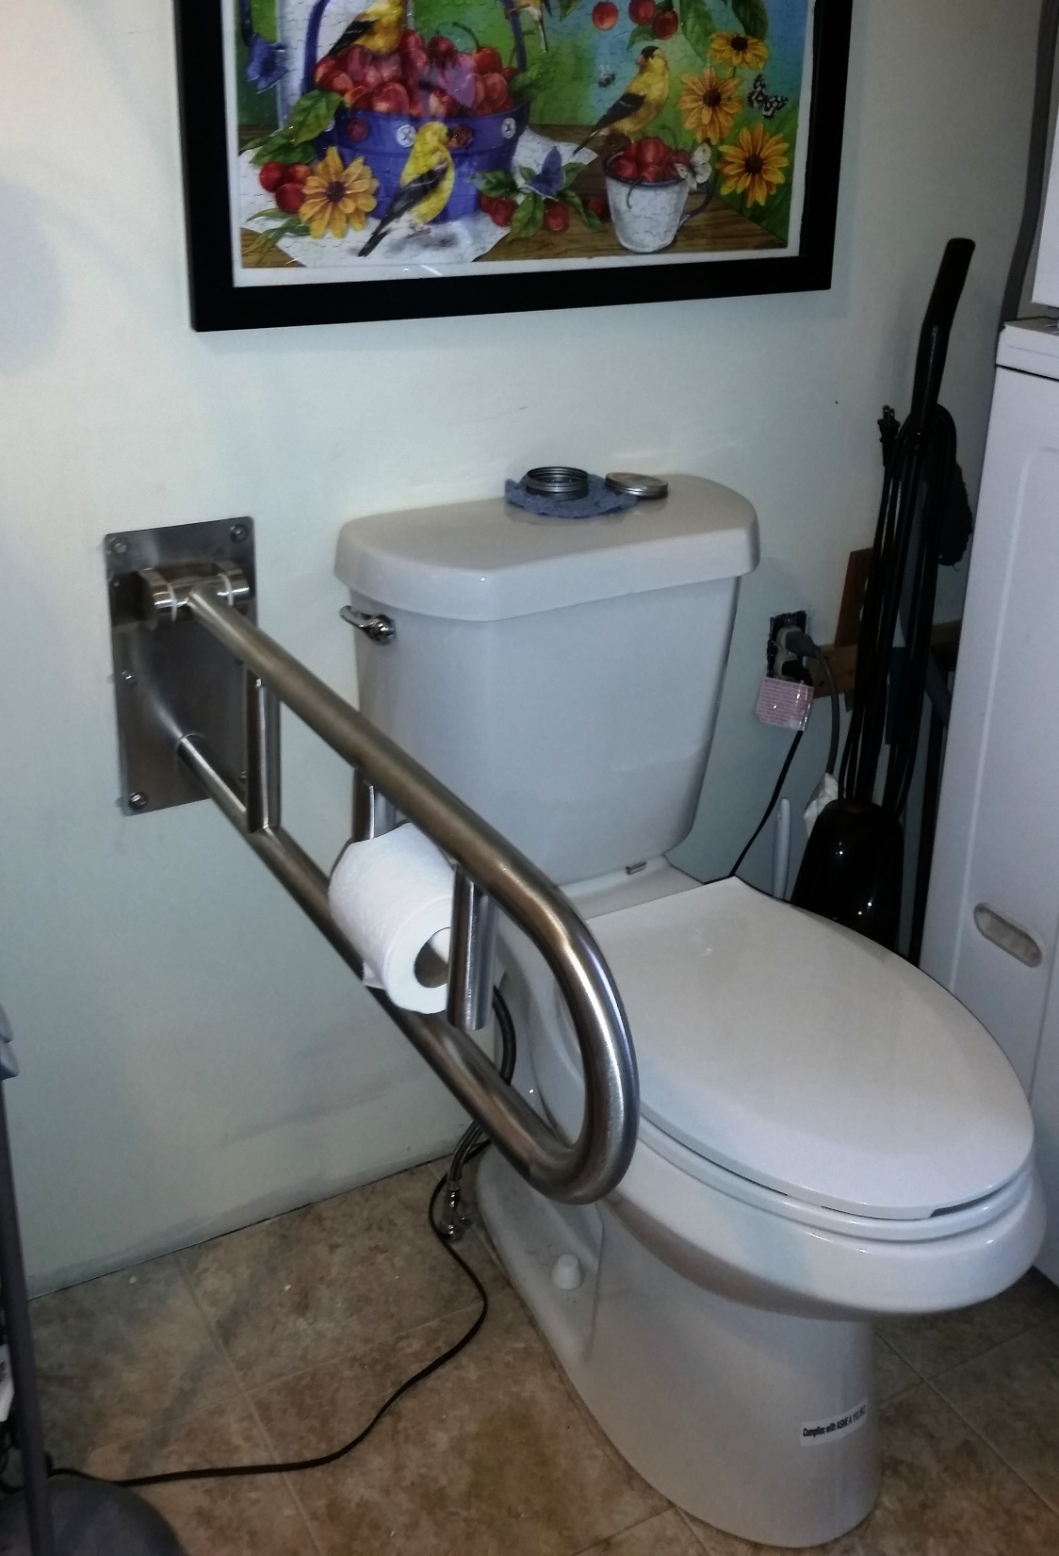
Aging-in-place is a constant worry for me. I would dearly love to remain in my home, but need a little help.

Slide 7
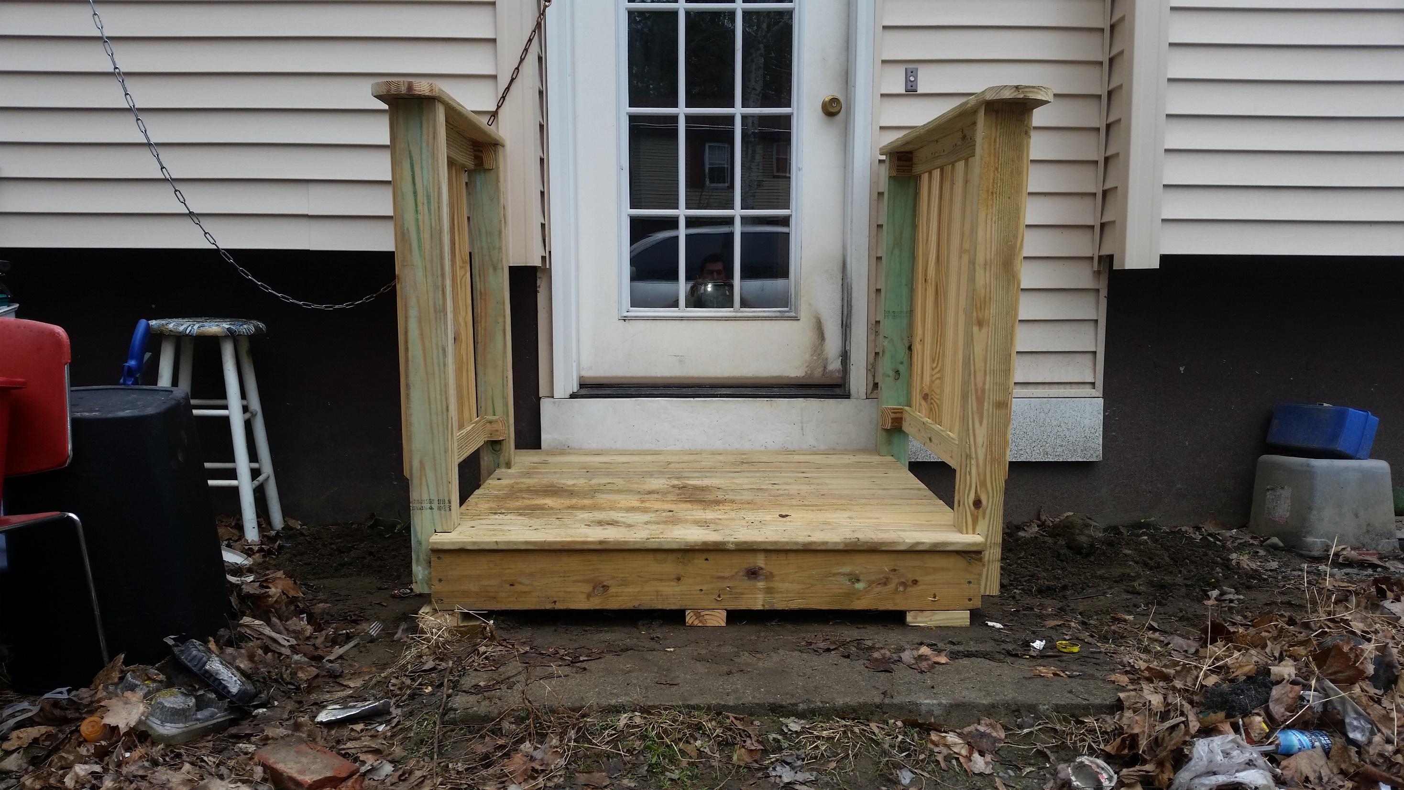
To be a king or queen of my castle

Slide 8
Control

Slide 9
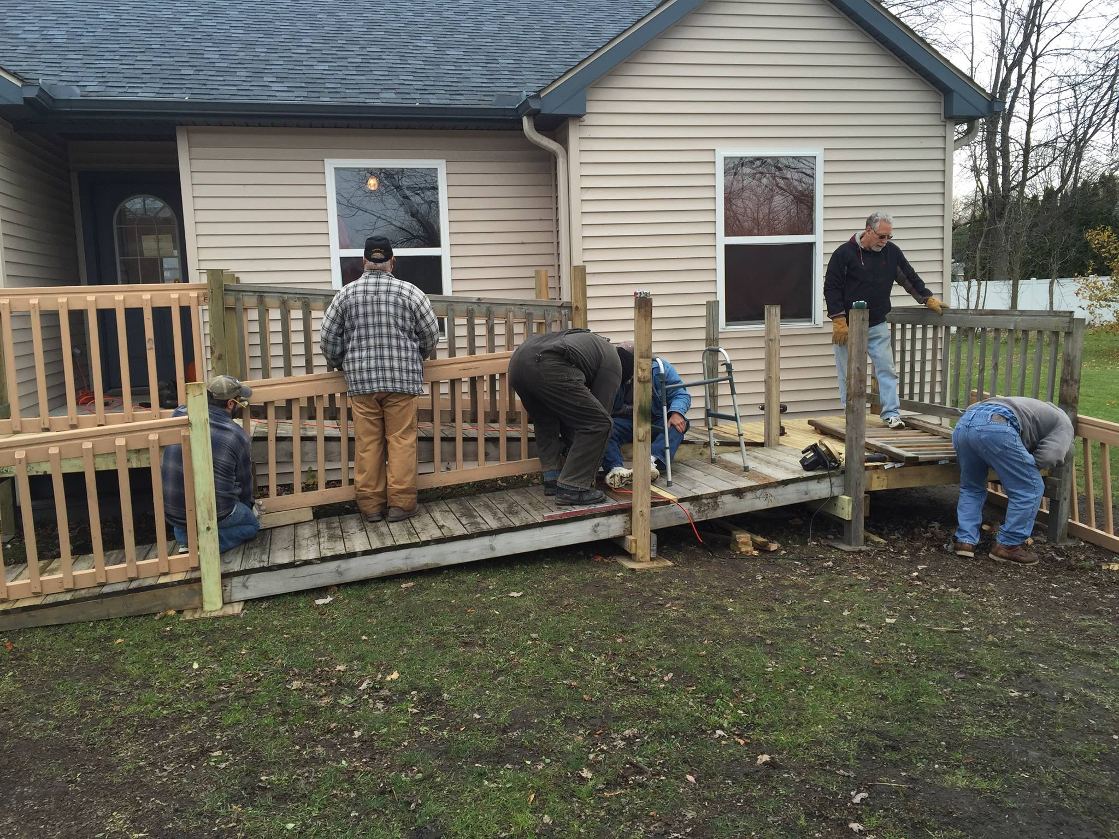
I just can't find the words to tell you how very grateful I am for the work your team is doing.

Slide 10
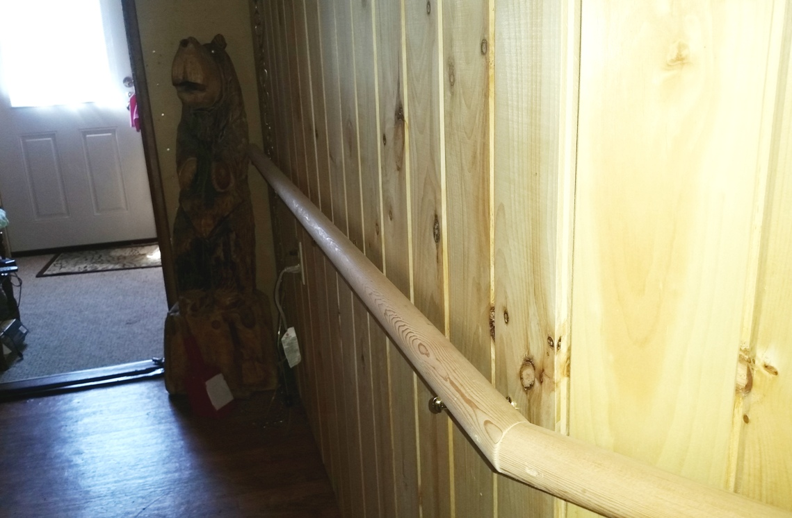
I love my home so very much, and the work you're doing lets me stay in it.

Slide 11
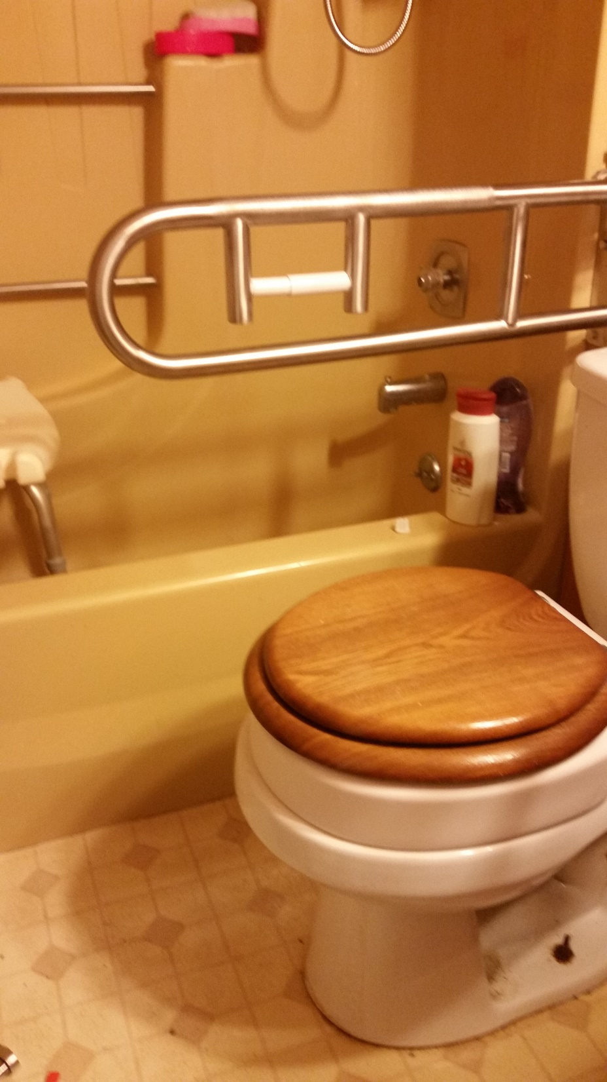
Without your help, there's no way I could keep living here.

Slide 12
Adapt

Slide 13
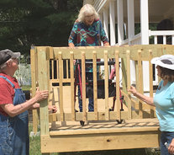
I'm pleased with everything. Turned out great. One of the greatest organizations in the state.

Slide 14
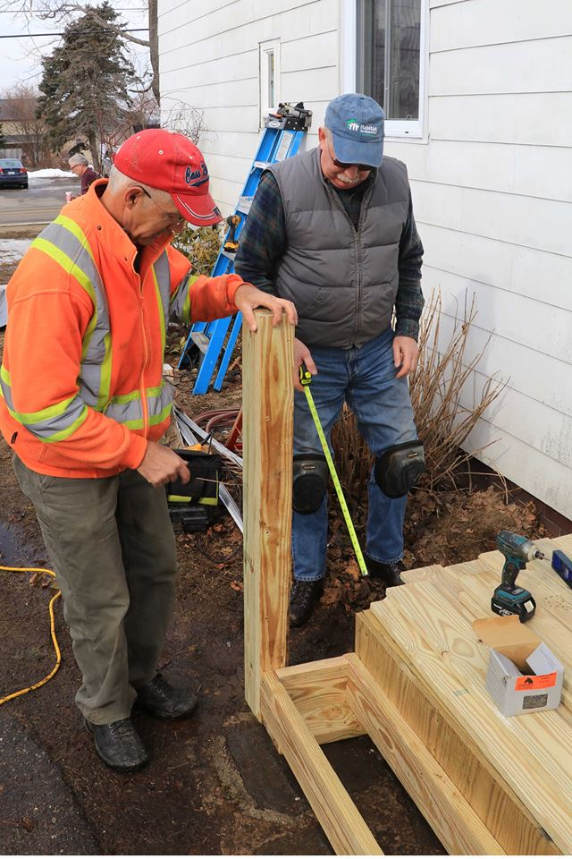
We are just so happy with everything. I can't thank you enough. You don't know what it's like to do laundry upstairs now. Often times laundry wouldn't get done.

Slide 15
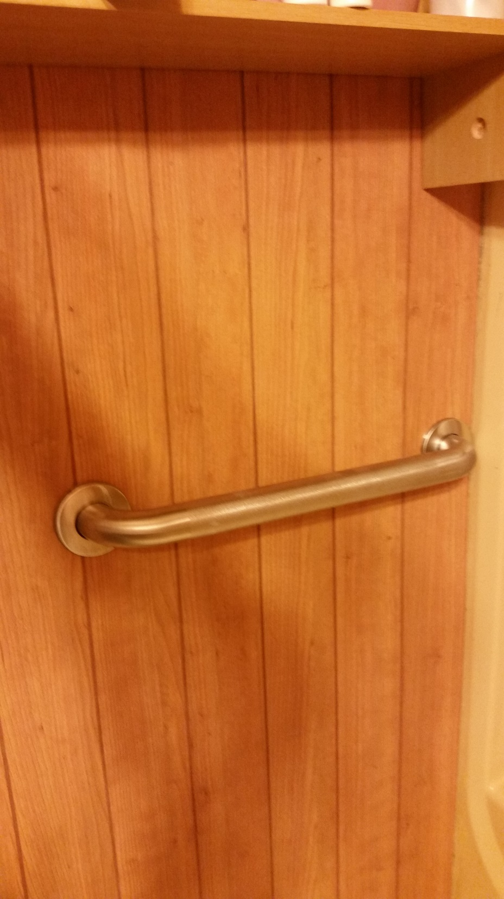
I love the grab bars in the shower. What a difference. I can't believe I have gone this long without them. I feel much safer. Thank you!

Slide 16
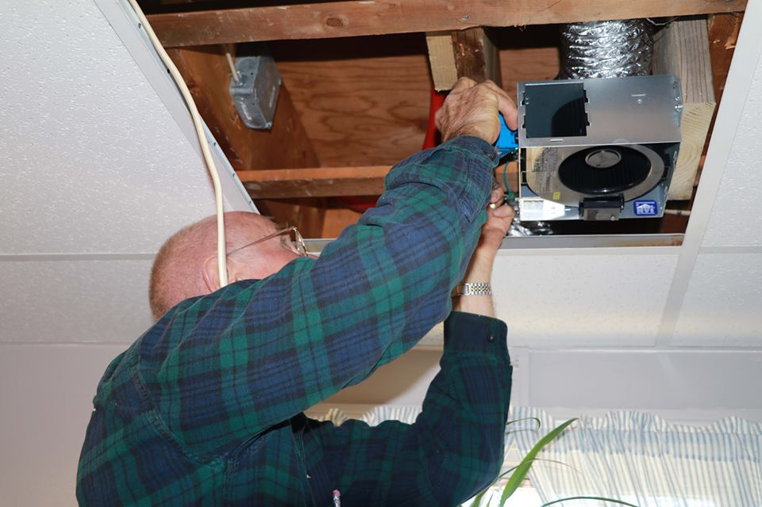

Slide 17
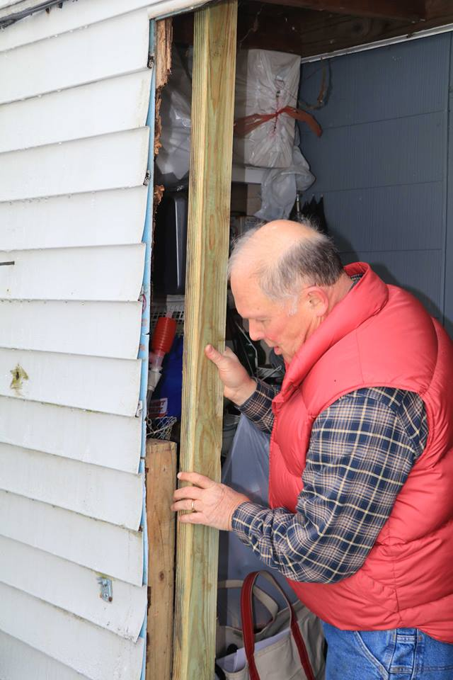
Thank you all so much. Josh is a worker - he just goes and goes. I used the back door steps for the first time in years! I'm going to put a chair out there.

Slide 18
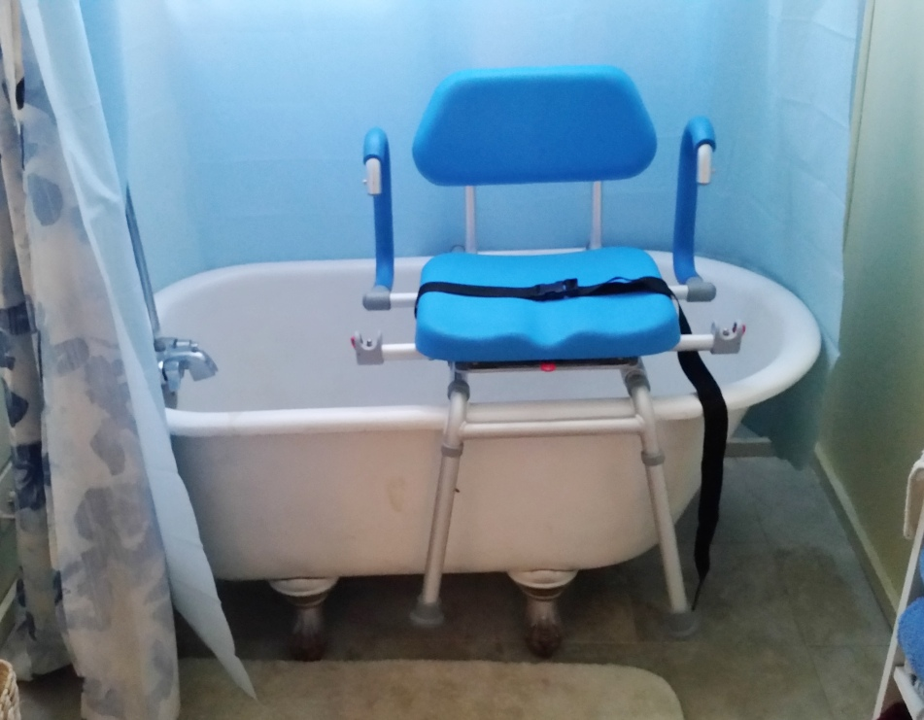
I want to let you know how much I appreciate the work you are doing on my home.

Slide 19
90% were SURE that home modification had a positive effect on their financial situation.

Slide 20
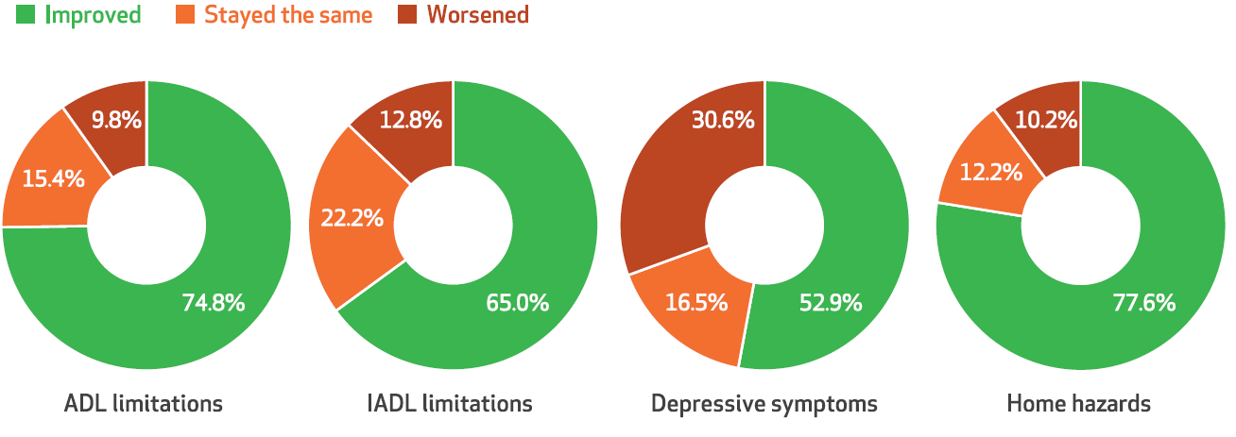
62% of those receiving home modification services reported an improvement in their ability to live independently in Maine.
I(ADL)=Independent (Activities of Daily Living)

Slide 21
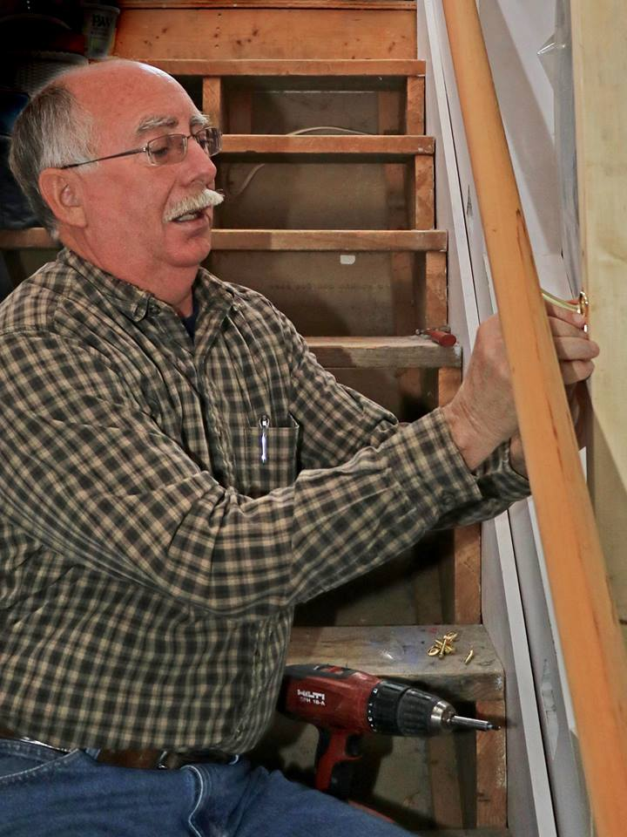
I'm not sure what I am enjoying more -- the good weather or the handrail. Just the one Josh has put in has made it so much easier for me to get down to my driveway.

Slide 22
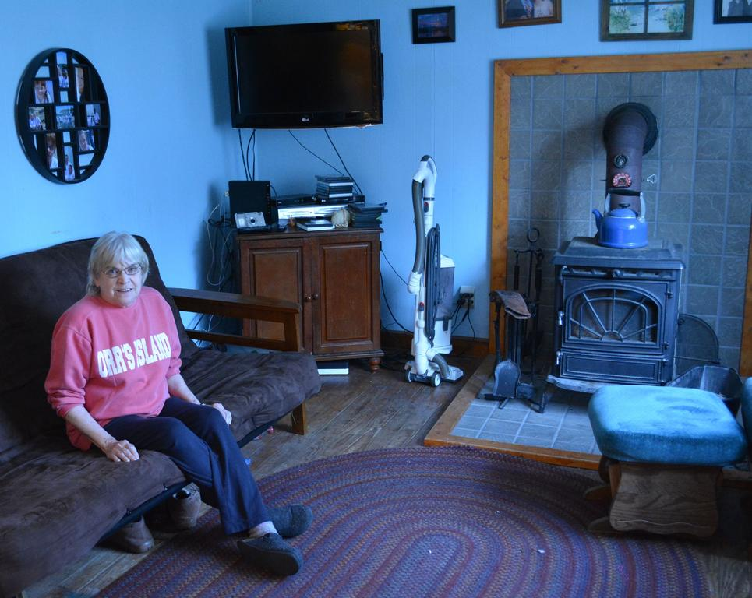
I live alone and my household is single-income –
I sometimes wonder how I'm going to keep on top of everything I need to get done. Thanks so much!

Slide 23
94% had inadequate smoke and/or carbon monoxide detectors installed in their homes.

Slide 24
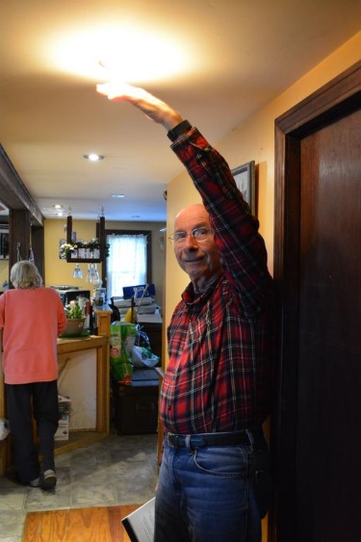
You have no idea how relieved I feel not having to worry about a fire when those lights are on.

Slide 25
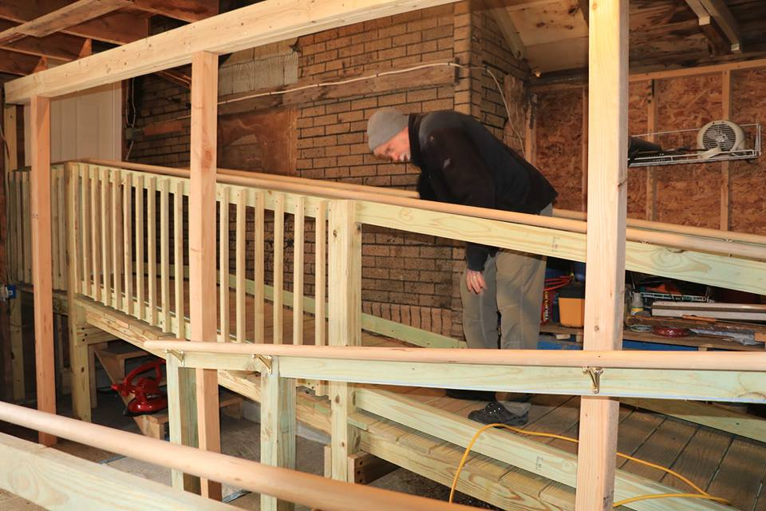

Slide 26
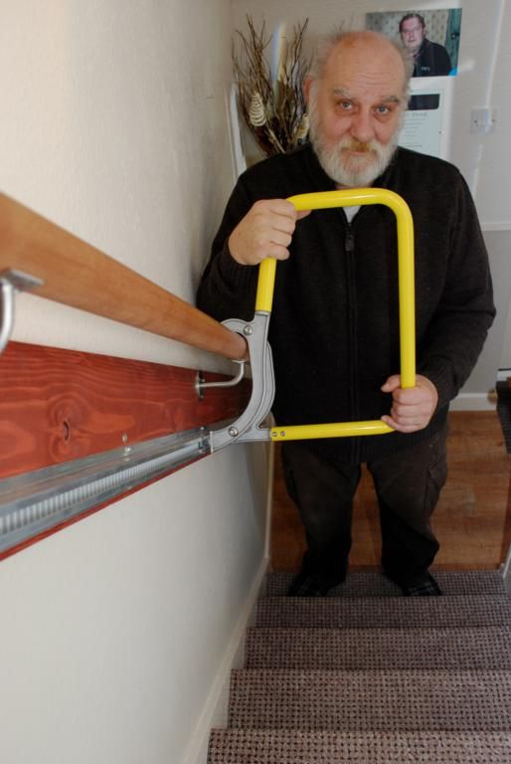
These repairs allow me to stay at home. I can't believe you're doing all of this for me at not cost; this is going to allow me to stay at home. I can' t tell you how much I appreciate all this work you're doing.

Slide 27
15% reduction in visits to the hospital following home modification and home improvements through these program.

Slide 28
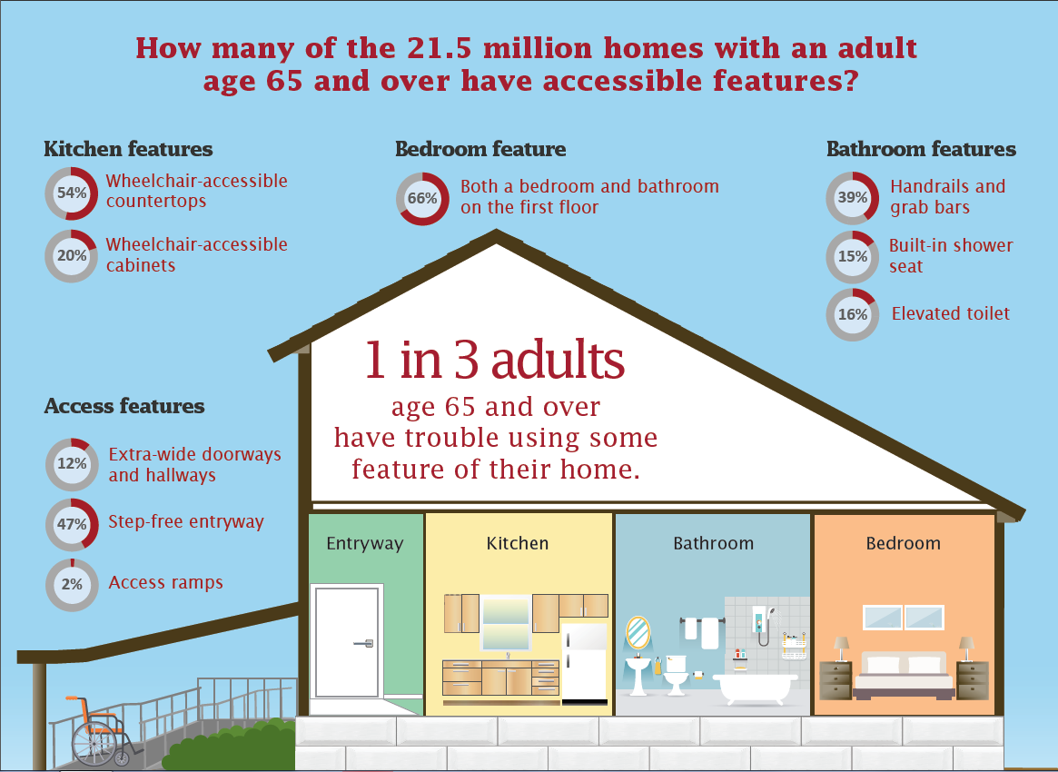

Slide 29
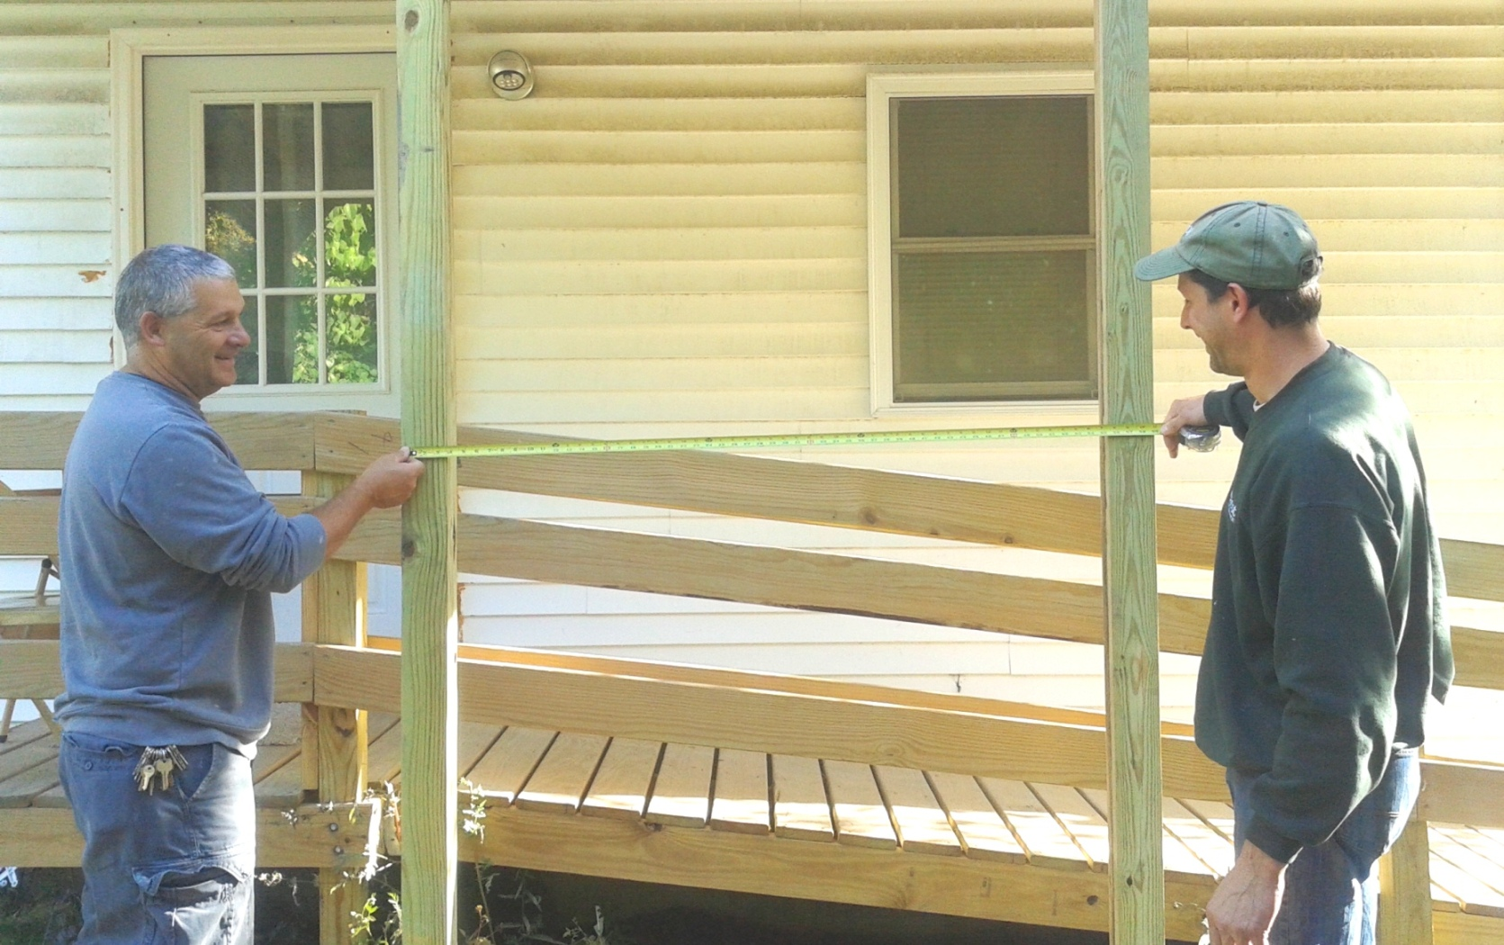

Slide 30
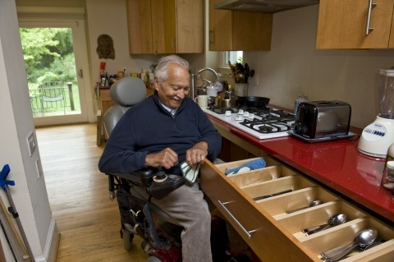
The LED bulbs have decreased his monthly electricity bill by $15 and he is relieved he will no longer have to stand on a chair or ladder to change the bulbs because they last longer.

Slide 31
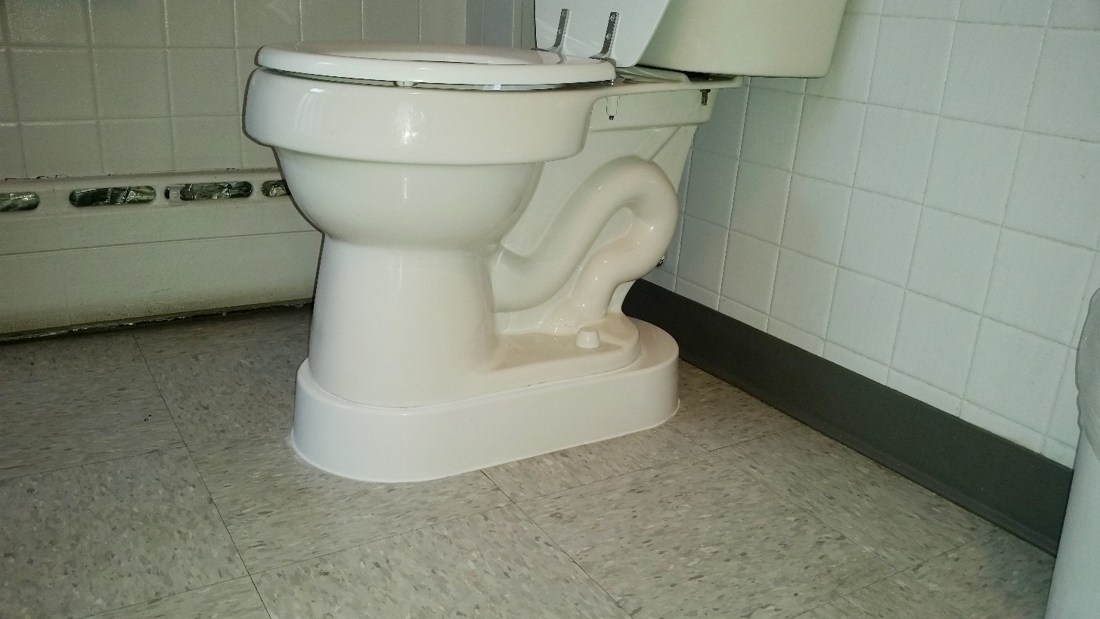
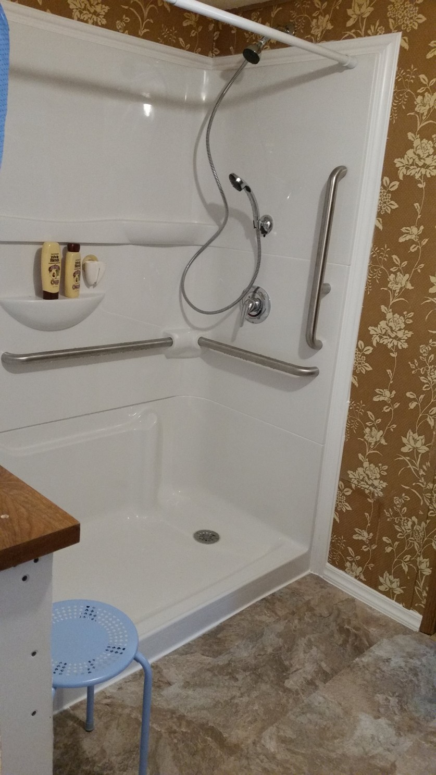
I can get in and out of my bathroom; it's just much more user friendly. And that door light makes a huge difference.

Slide 32
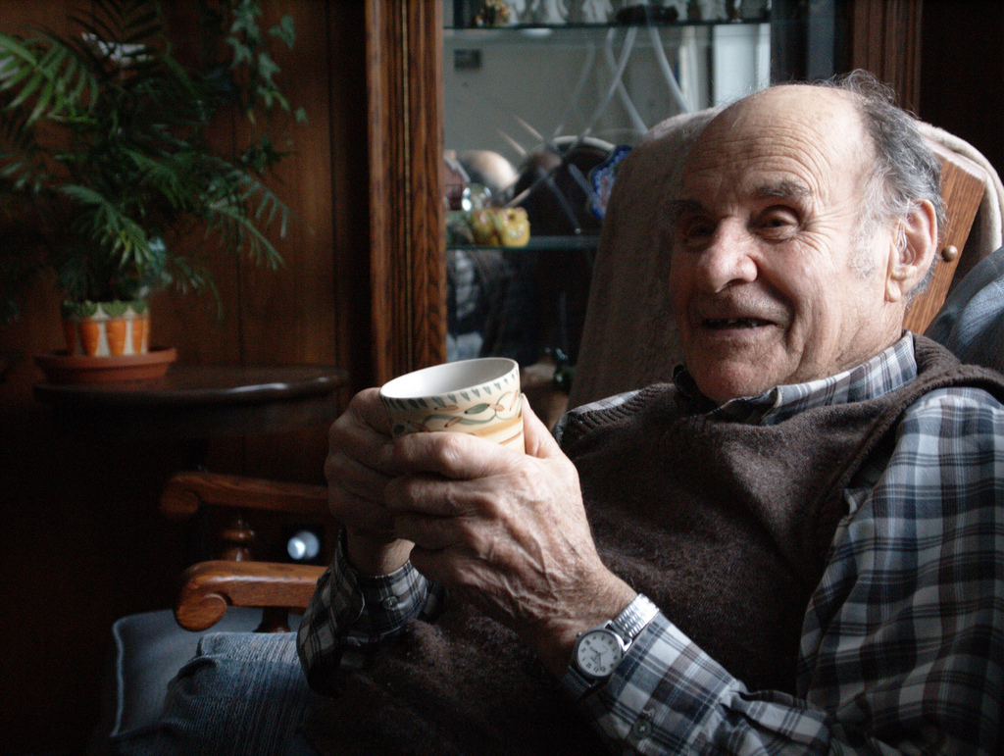
You have no idea how relieved my sister, brother and I are because of the work you're doing. We've been pushing really hard for a long time to move him somewhere else because we don’t want to lose him.
we can breath.
Now he can stay where he wants and.

Slide 33
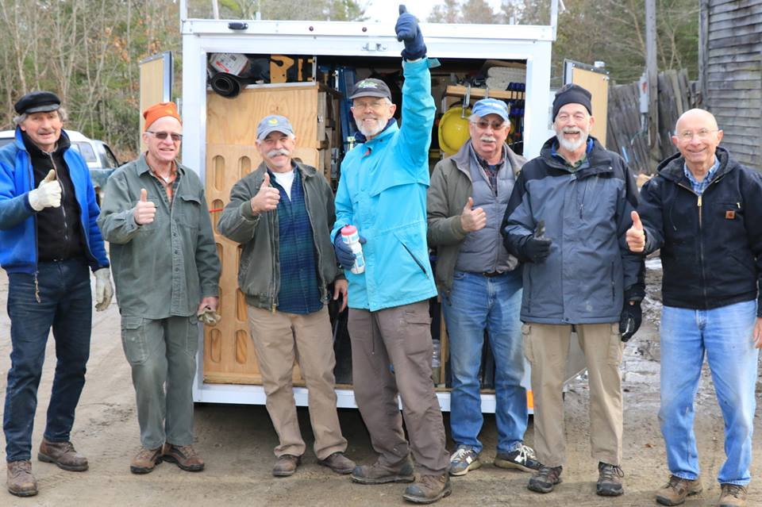
Not only does work that you are doing bring so much enjoyment and relief to them, but it also helps the rest of the family, knowing that their loved ones are safe, where they want to be.

Slide 34
Home Modification Cost
$72.00-$1,398
Emergency Room Visit with Discharge Home
$3,294
Hospital Stay
$31,091
Skilled Nursing Stay
$13,475
Home Health
$3,813
Low Cost
»
High Impact

Slide 35
Remodel
Low-Cost
High Impact
Do it Yourself
Barriers
Motivators

Slide 36
Remodel
Low-Cost
High Impact
Do it Yourself
Barriers
Motivators

Slide 37
Remodel
Low-Cost
High Impact
Do it Yourself
Barriers
Motivators

Slide 38
Remodel
Low-Cost
High Impact
Do it Yourself
Barriers
Motivators

