Slide 1
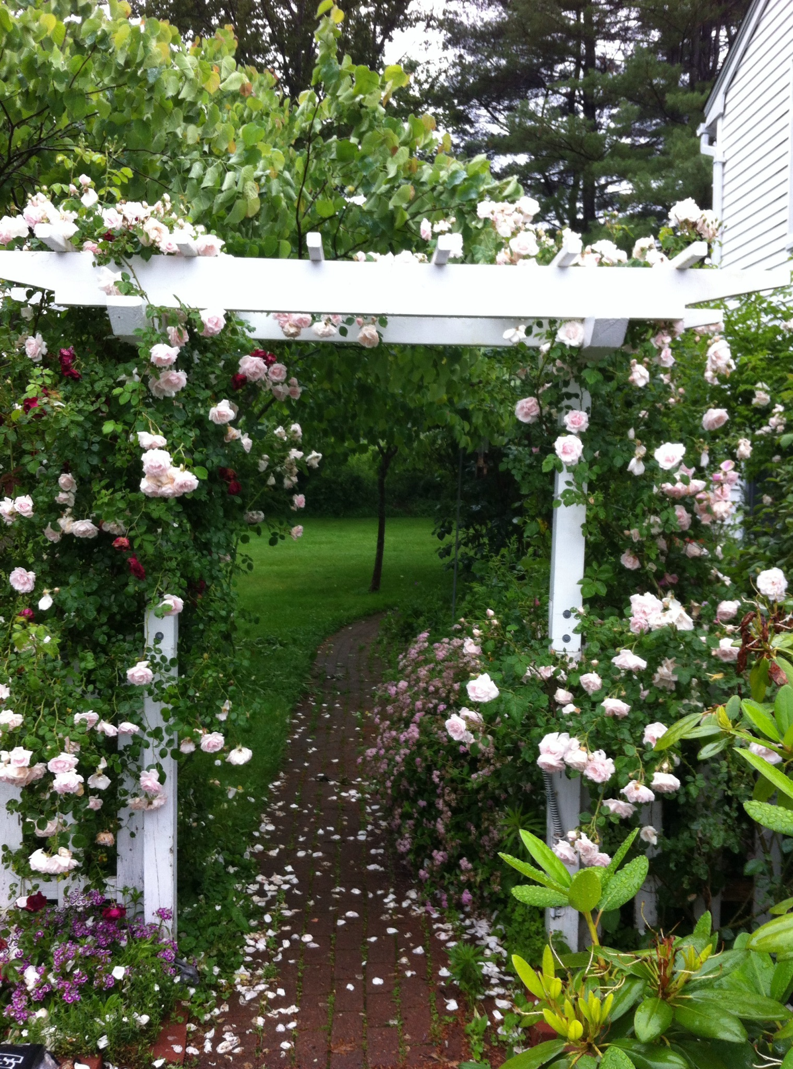
Accessory Dwelling Units
Tom Emerson - Architect, Planner, ADU owner
Maine Council on Aging

Slide 2
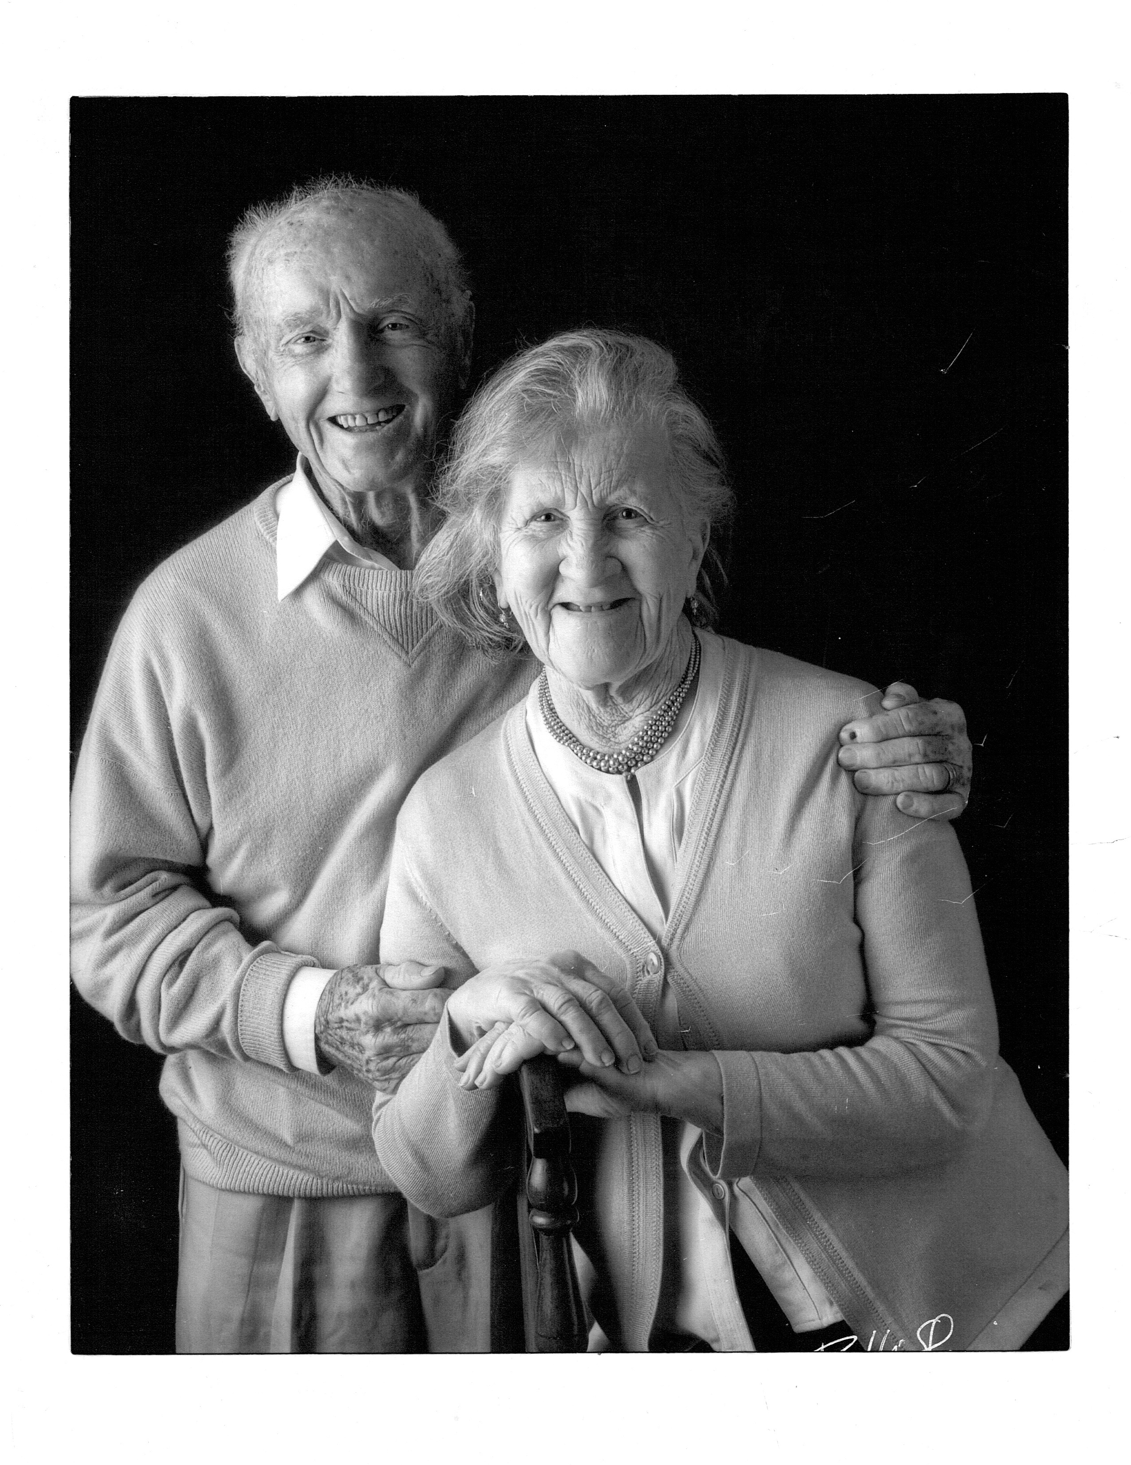
ADUs & Aging in Place:
from my perspective

Slide 3
What is an ADU?
(from HUD)
Accessory dwelling units (ADUs) — also referred to as accessory apartments, second units, or granny flats — are additional living quarters on single-family lots that are independent of the primary dwelling unit.

Slide 4
Benefits of ADUs
Allows residents to age in place.
Provides additional income.
Can facilitate caregiver situations.
Lowest barrier to entry - least expensive way to create housing.
More likely to be affordable.
Homeowners, not developers - money stays in the community.
Increases property values = increases tax revenue.
Can help reduce sprawl & environmental damage.

Slide 5
Scenarios:
from an Aging in Place perspective
Homeowner renting out the accessory unit or units for the income either full time or seasonally.
Owner living in the ADU & renting out the main house & possibly another ADU.
Owner living in the primary unit & a care giver, either a family member or a non-family member in an ADU. The caregiver may or may not pay rent.
Owner in one ADU, caregiver in another & the primary residence rented.
An owner living part of the year in either the primary or accessory units and renting their residence out seasonally.
The owner living off site, potentially with family or in assisted living & renting the property to generate income & keep the asset in the family.
The idea is to give the older homeowner options.

Slide 6
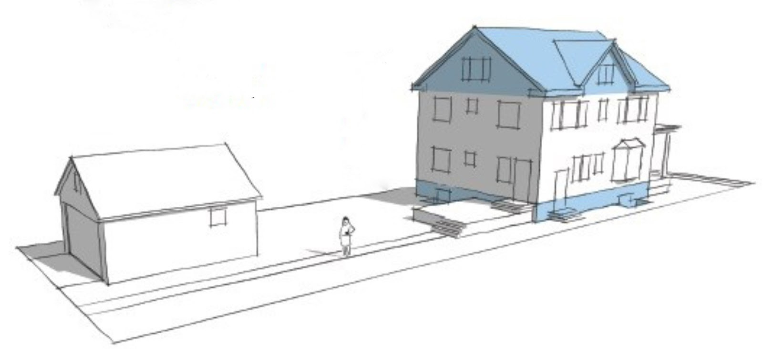
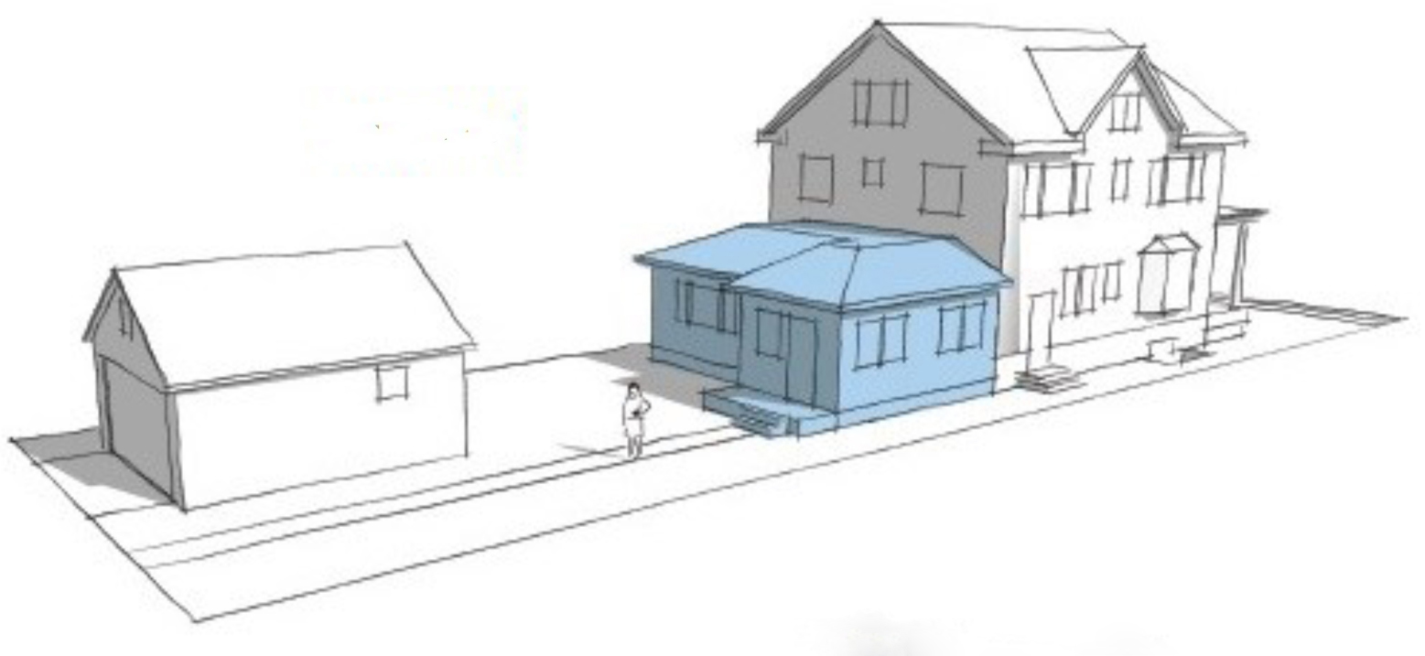
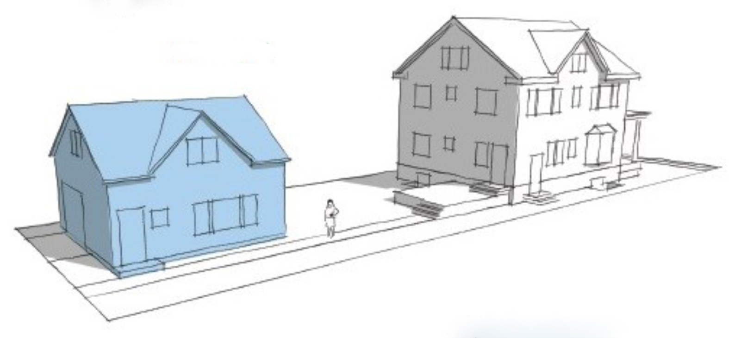
Internal
Attached
Detached

Slide 7
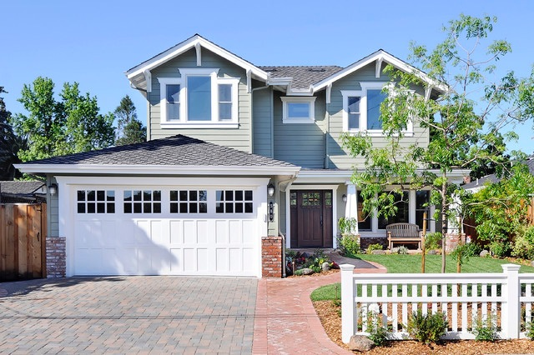
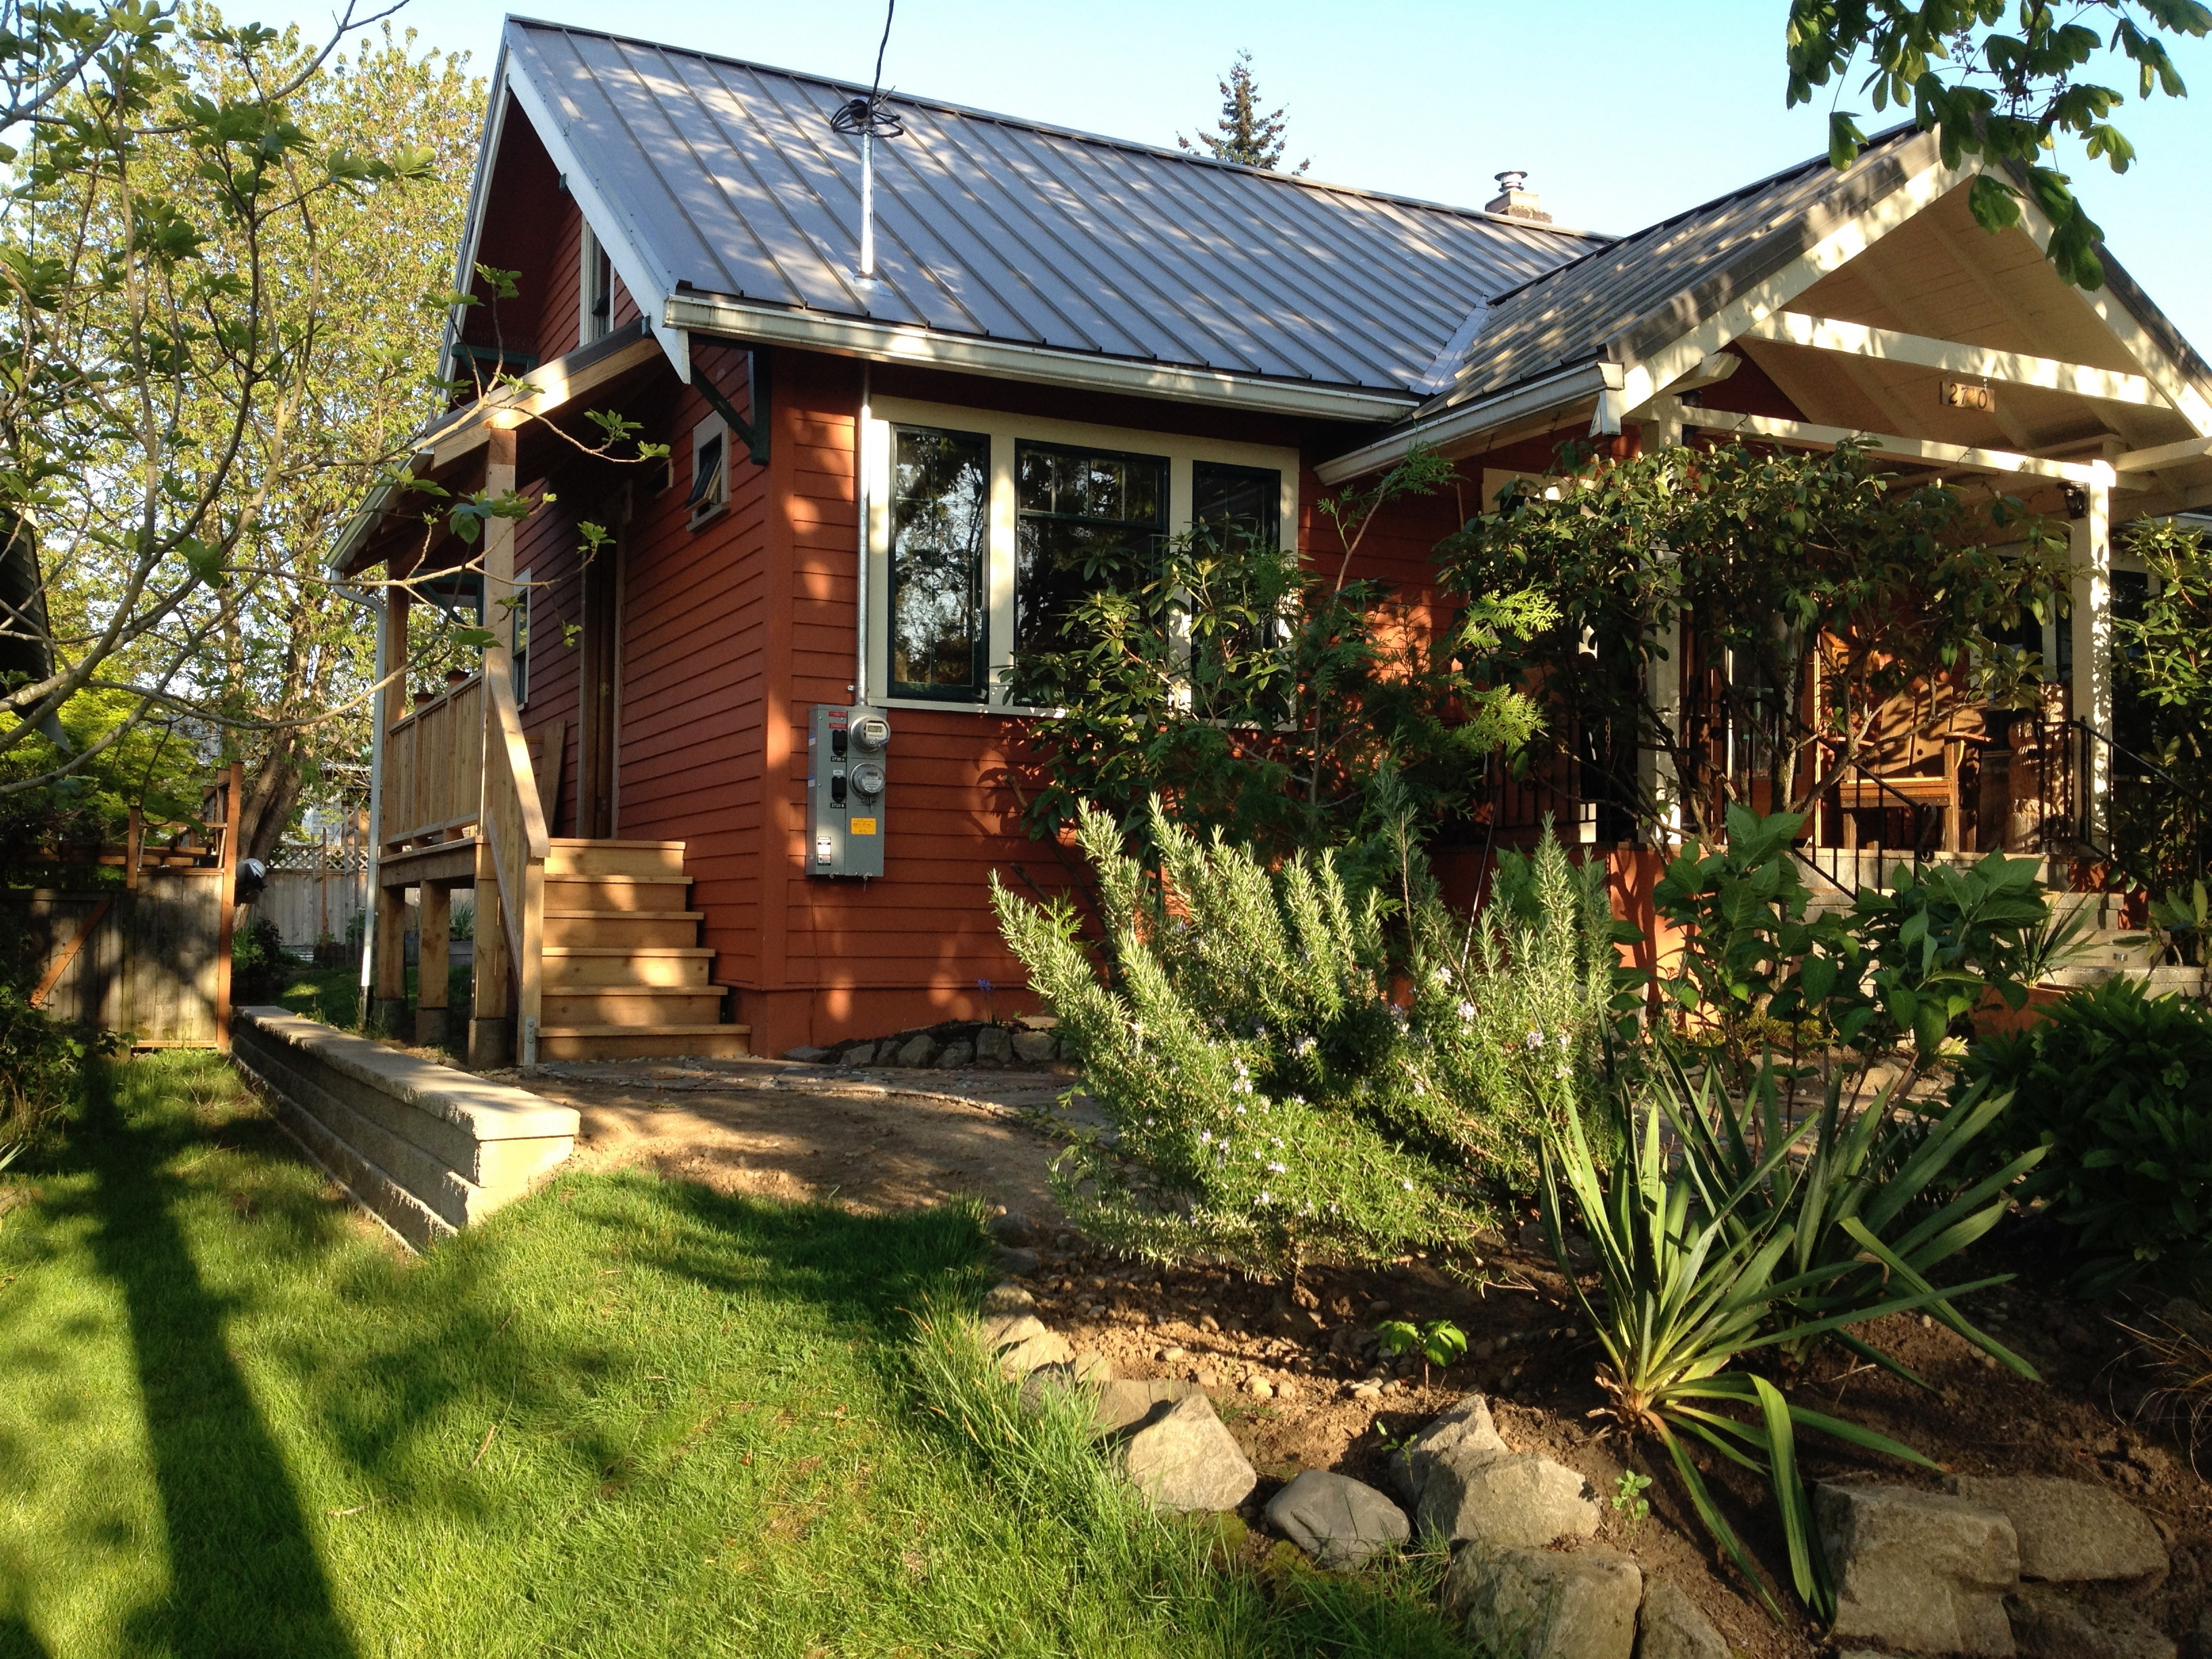
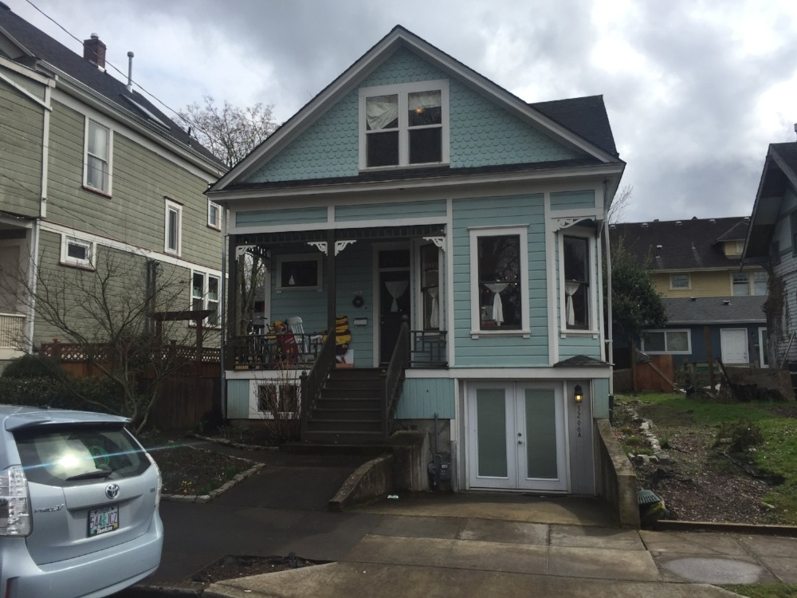
A
Internal units can be
invisible (A), almost so (B)
or pretty obvious (C).
B
C

Slide 8
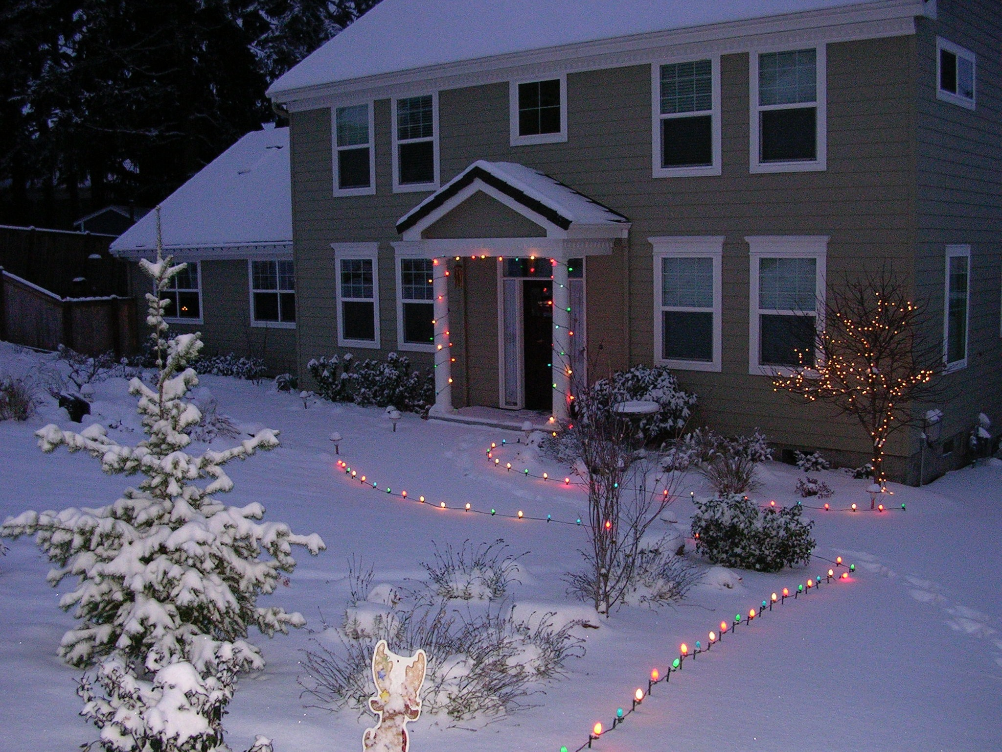
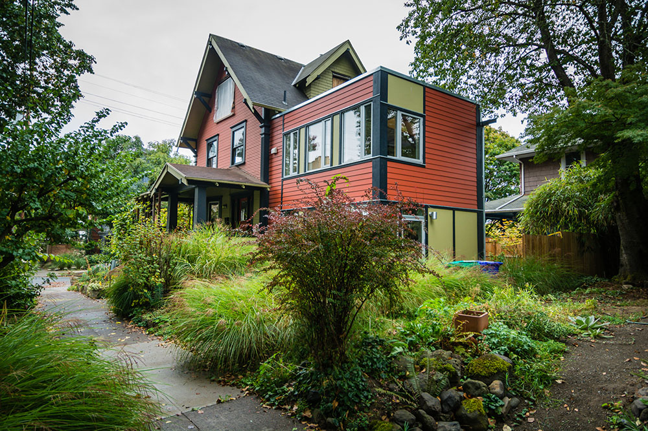
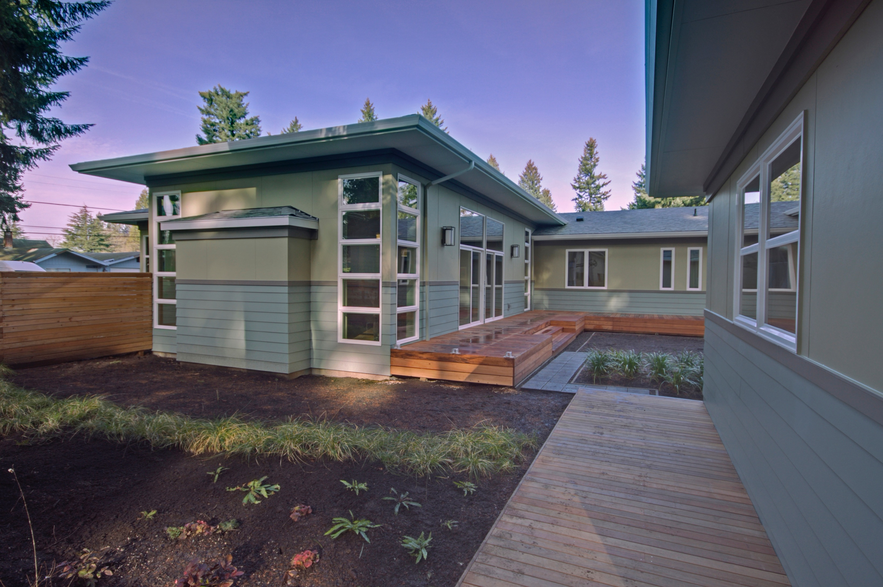
A
Attached units can blend in
(A), stand out (B) or be
hidden in the back of the
house (C).
B
C

Slide 9
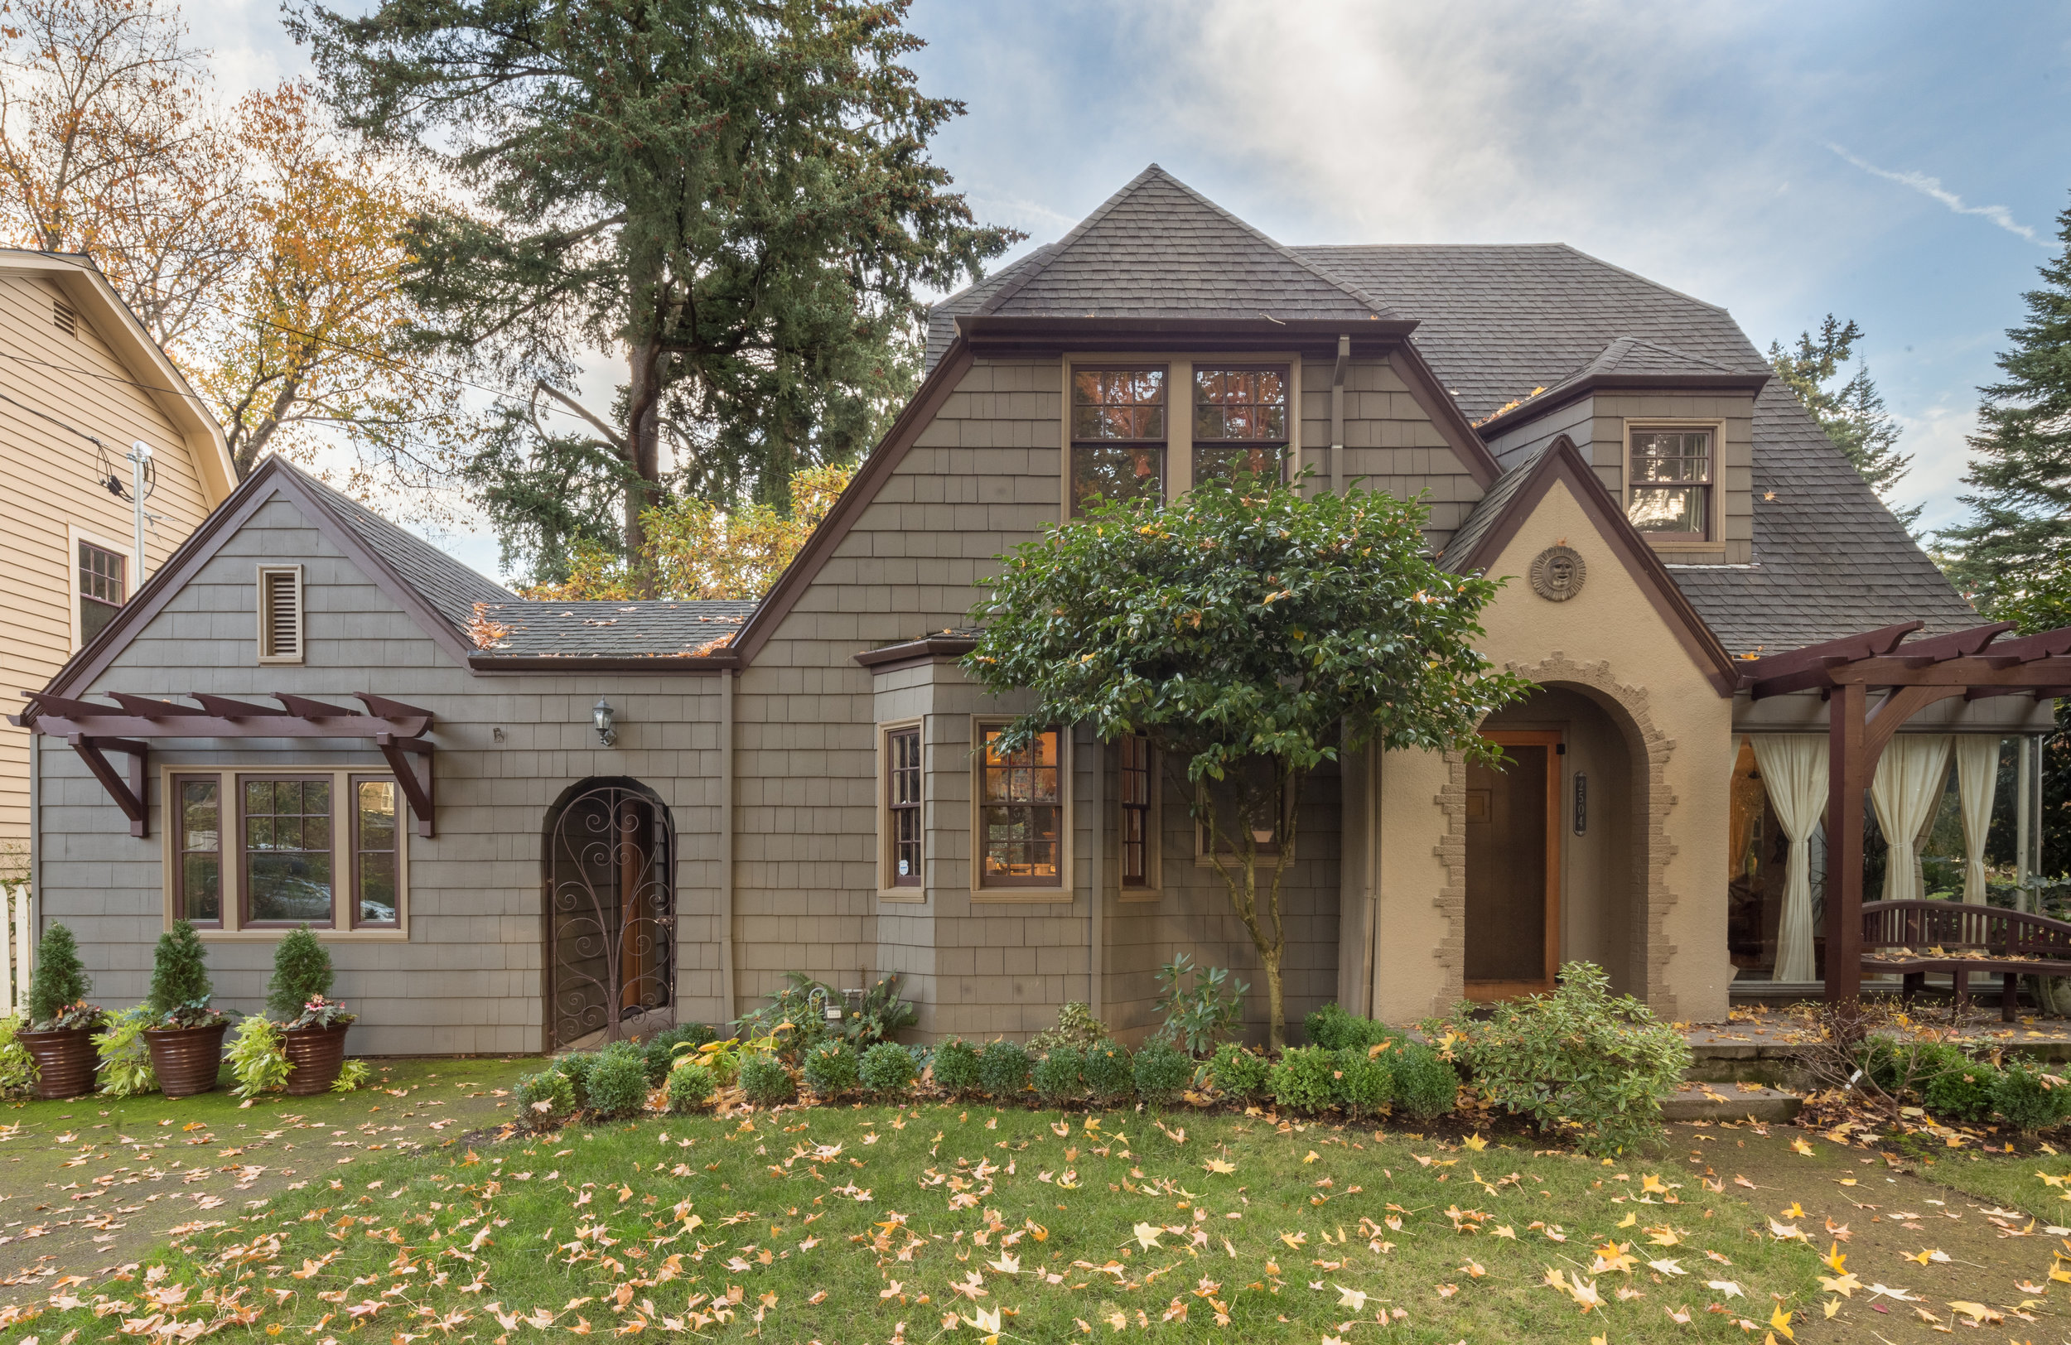
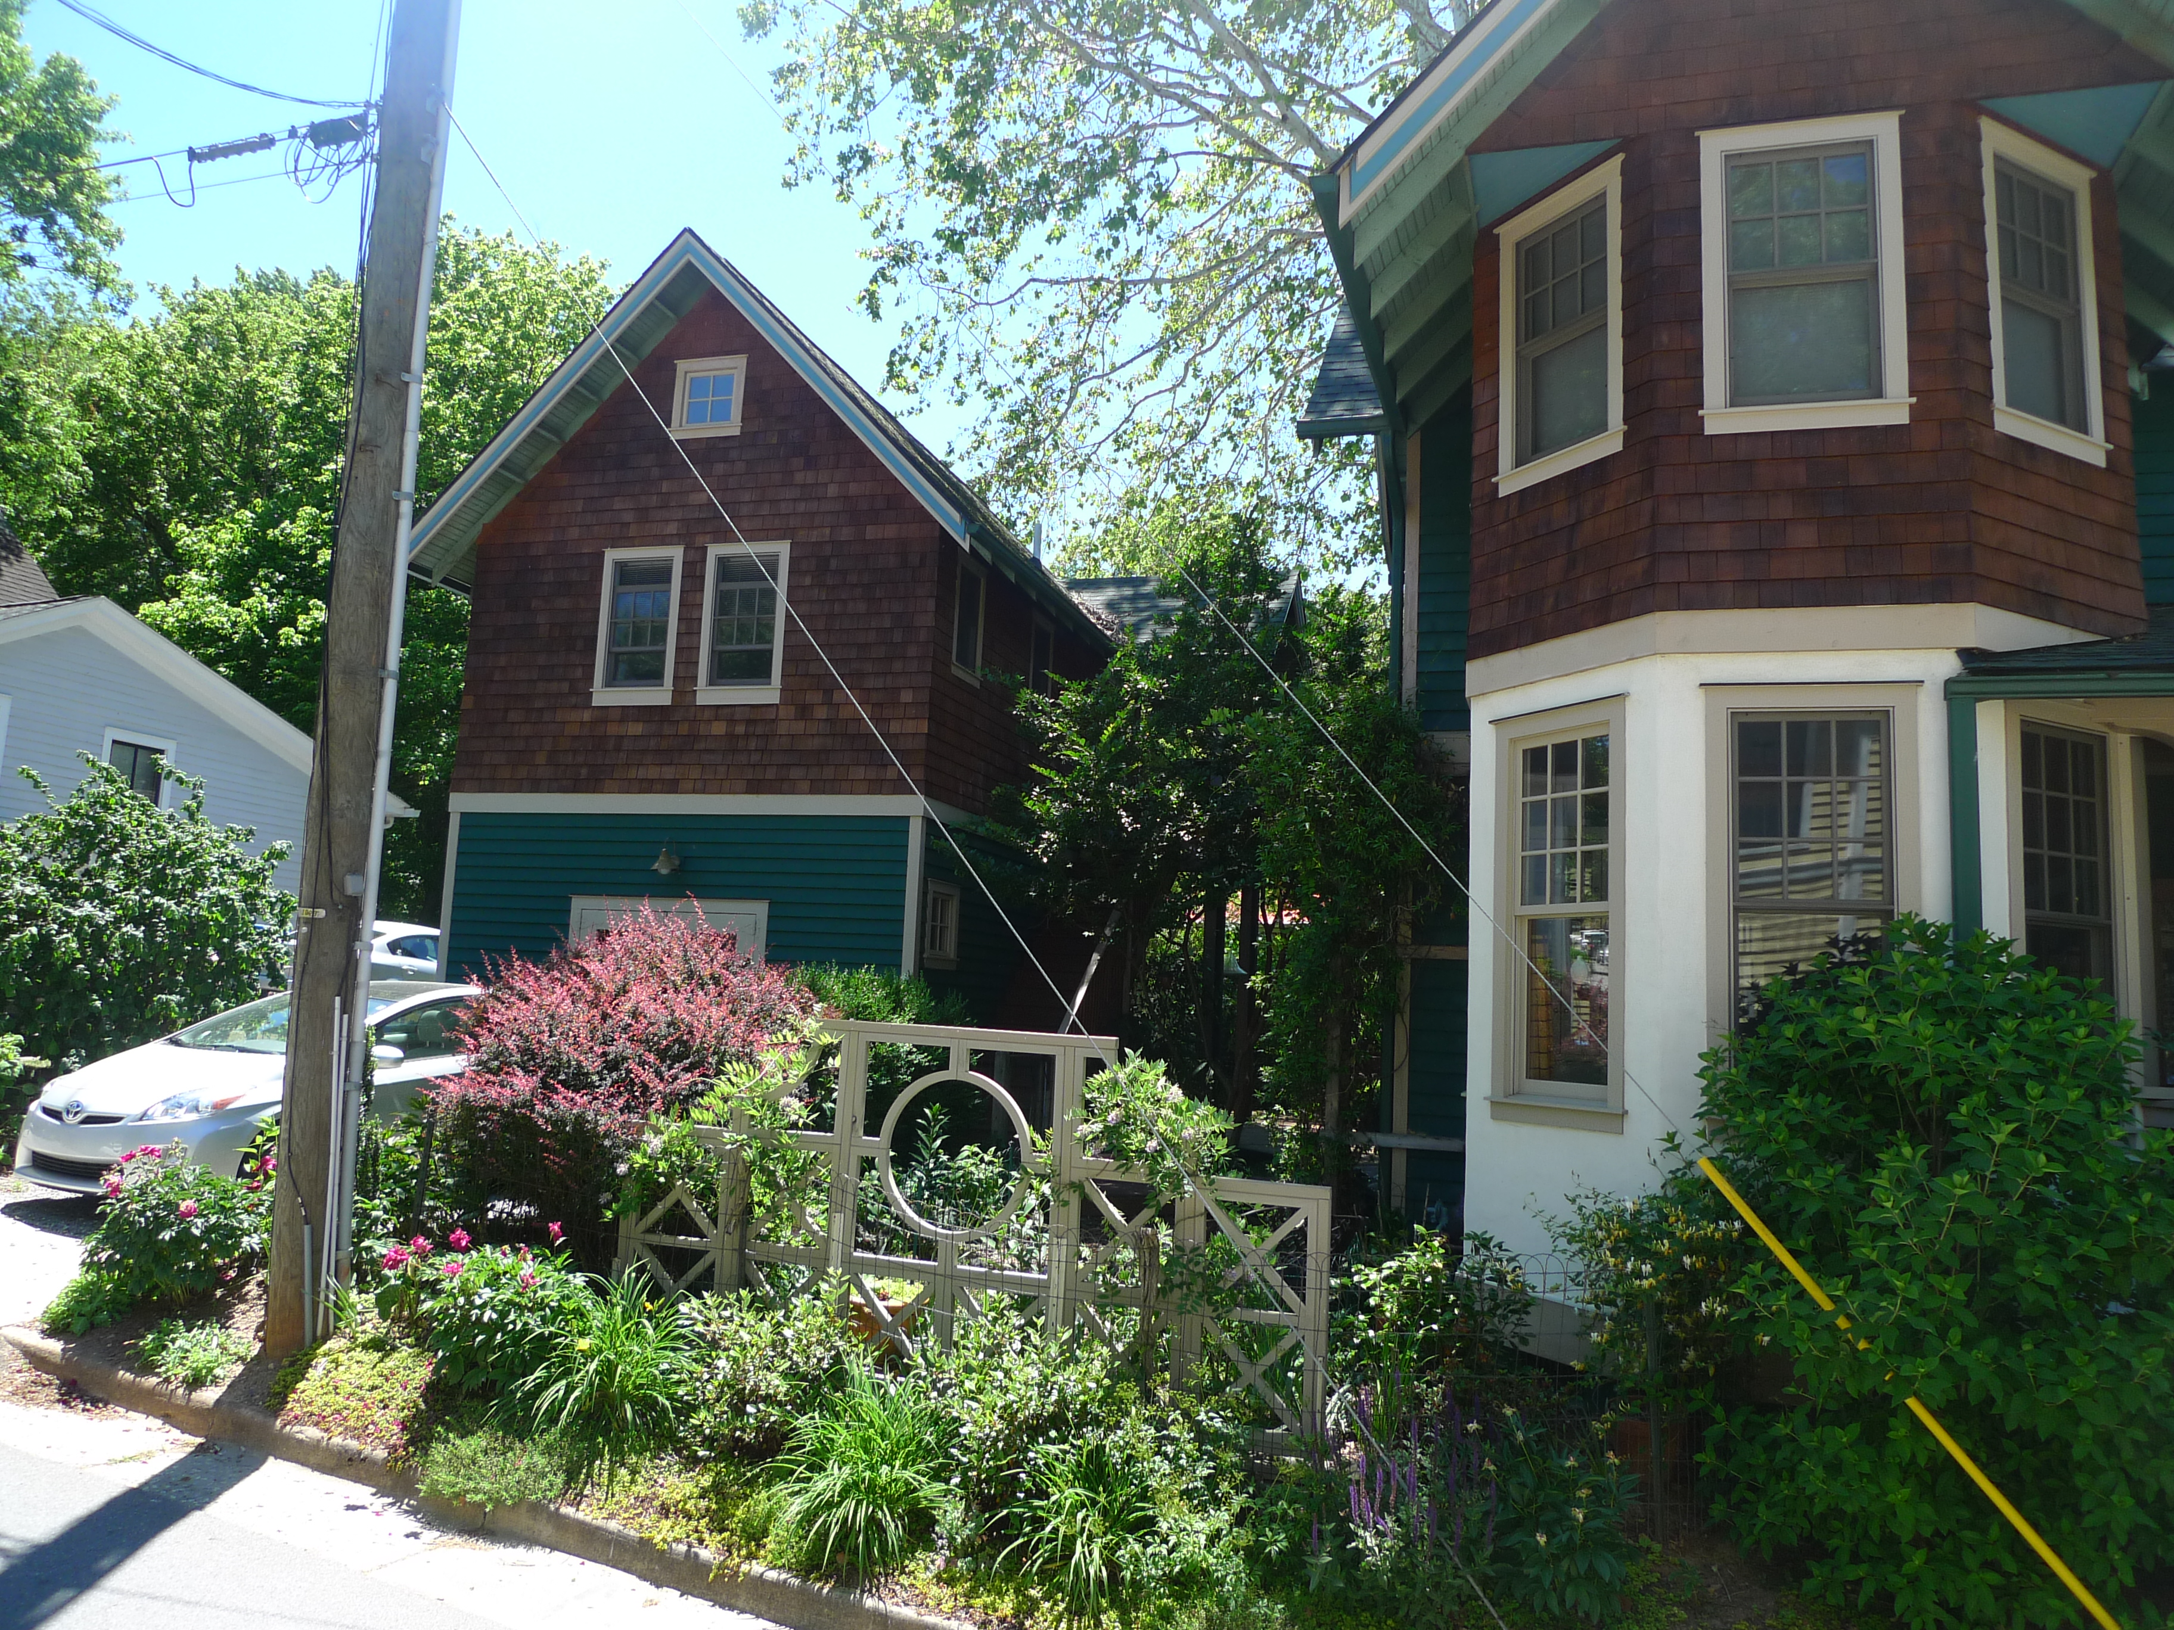
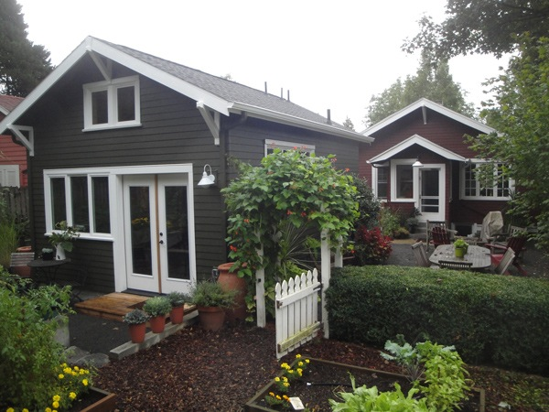
A
Detached units can retain
the character of the primary
building…
B
C

Slide 10
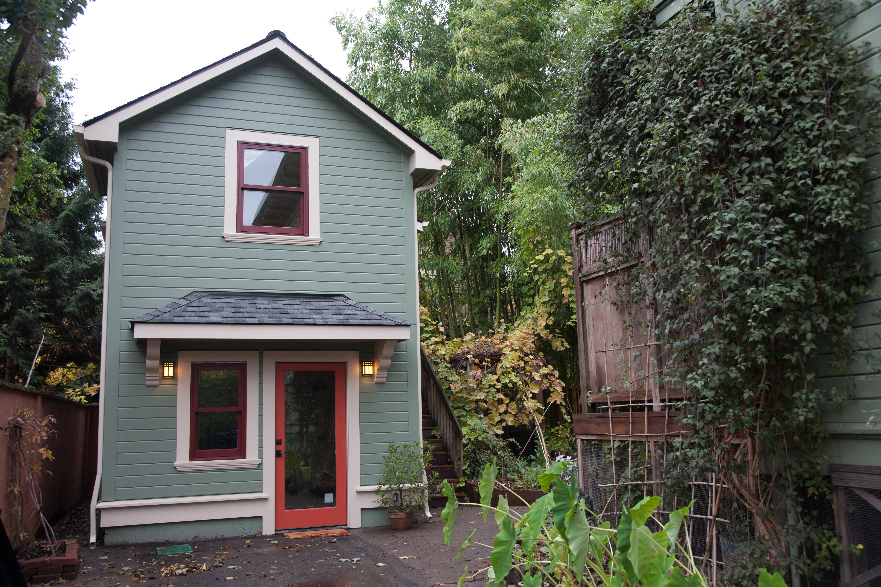
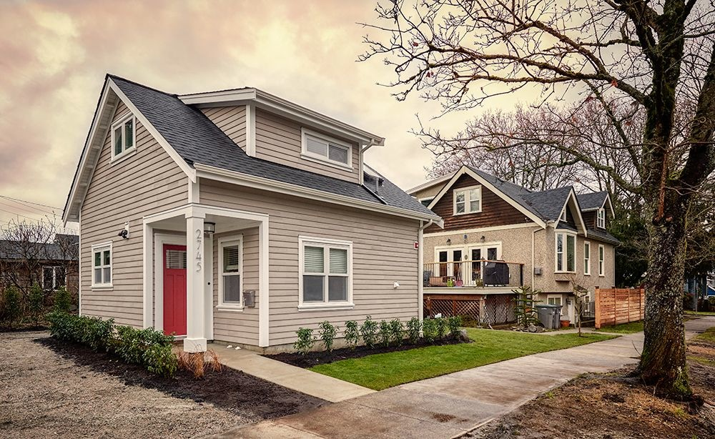
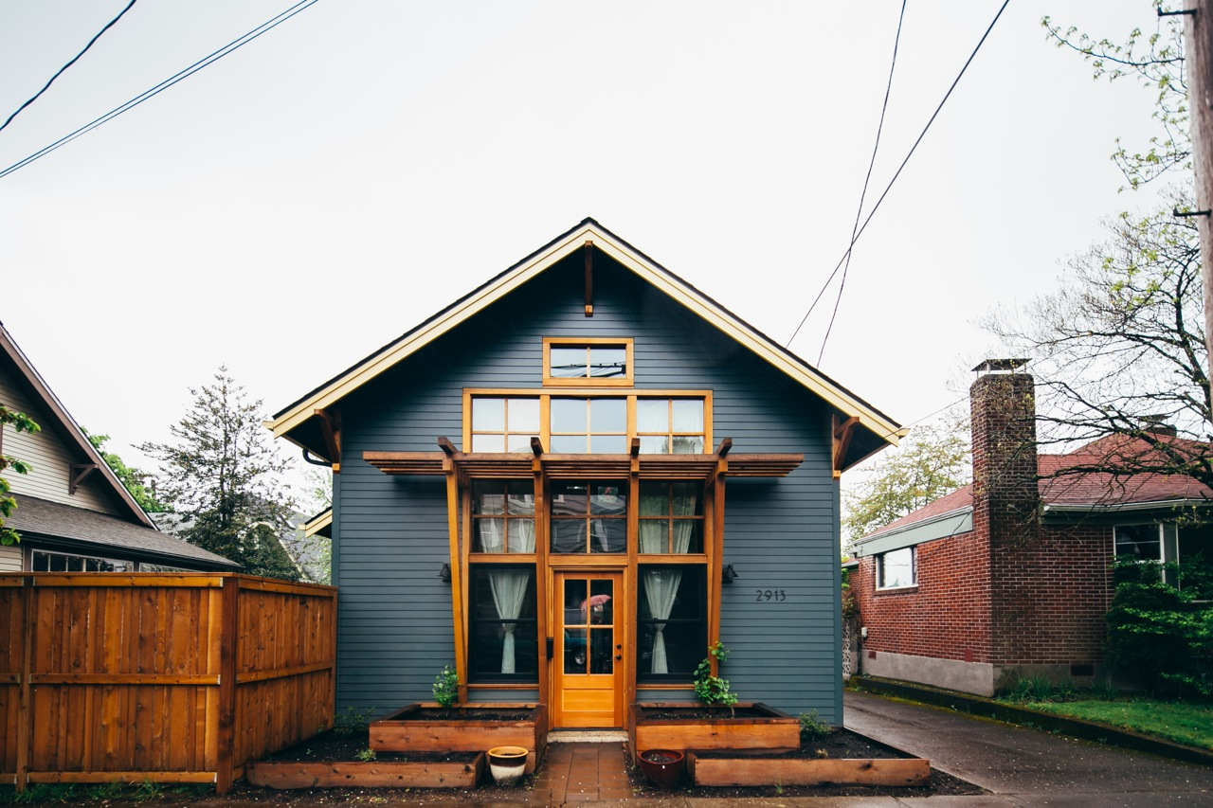
A
…or have a character
of their own.
B
C

Slide 11
Barriers to ADU Construction
Building size limits:
Anything less than 600 square feet becomes problematic because that size allows for a separate bedroom, bathroom, kitchen and living room. For two residents, perhaps an older person & a caregiver or a family, you need more space.
Caps on detached ADUs at 30 percent of the size of the main house, which would be 450 square feet for a 1,500-square-foot main house, decrease the utility of the structure.
Model state rules issued by the Oregon Department of Land Conservation and Development suggest ADUs should be allowed up to 800 to 900 square feet, close to Portland's limit of 800 square feet (or 75 percent of the main house.)
Units built with the intention of housing somebody with mobility impairment need to be bigger to allow ease of movement.
Owner occupancy:
Most jurisdictions require the owner to remain living in either the main house or the ADU. This can be a “Deal Killer”, especially as owners age and for lenders concerned they might find themselves owning the property.
While seemingly reasonable, such rules can reduce the actual property value because of lost flexibility for owners and make lenders less willing to provide a construction loan to build an ADU.
Local Zoning/Building Constraints:
Lot size, setbacks, lot coverage, footprint, height, rights of way & easements…the same things that affect any other type of building.
Communities need to consider the effect of nonconforming buildings & lots as well as all of the above.
Off-street parking:
Can add $10,000 to $15,000 in costs to pave a driveway.
Many lots can't accommodate new parking spaces. Portland, OR allows tandem parking.
Onerous fees & difficult permitting processes:
Many jurisdictions levy thousands of dollars in systems development charges on each new ADU — the same as they charge for regular houses — to cover the cost of providing parks, sewers, water, streets and other services.
Portland, OR, where such development fees typically top $16,000, found that waiving those fees for new ADUs led to the current ADU construction boom.
Jurisdictions might consider scaling back those fees, with the recognition that ADUs usually house fewer residents than a regular house.
Streamlining processes for folks who are not generally exposed to the permitting process eases homeowner concerns.
Some communities require that the ADU must resemble the main house architecturally. That usually adds to the cost.
Finance/Appraisal:
Some banks won't loan money based on homeowners' ability to make payments by renting out the ADUs. That cuts modest- and low-income homeowners out of the market.
In places where ADUs are not prevalent, finding comps to determine market value can be difficult.
ADU specific loan programs are scarce.

Slide 12
Lessons Learned:
from models in other places.
Flexibility is paramount - an ADU is living space that can be:
A dwelling.
A rental - long term, seasonal or a short term rental (AirBnB).
A guest house or a home office.
Converted back into part of a primary dwelling.
Types of units - codes should allow all three. Codes that do not allow detached units see considerably fewer units built.
Number of units - more progressive ordinances allow two, one inside/attached & one detached. Three units, however, triggers Maine subdivision law.
Size of units - should be big enough to allow for two bedrooms, both for affordable housing reasons & for caregiver situations, regardless of the size of the primary dwelling.
Location of units - zones where growth is desired, residential & mixed-use are allowed and with some allowance made for non water & sewered areas. Areas within walking distance of amenities are ideal.
Owner Occupancy - not requiring owner occupancy is preferable to lenders & anticipates contingencies where an owner can receive income even if they move to a different type of care and don’t want to loose the asset.
Other occupancy restrictions - trying to steer occupancy toward or away from affordable housing or short term rentals and specifically for elderly housing reduces flexibility & therefore the number of units.
Architectural character - requiring a greater degree of review than other houses in a neighborhood is both unfair & likely more expensive.
Creating community loan programs or working with local banks can help make financing available.

Slide 13
Often Cited Neighborhood Concerns:
Not always valid, but…a lot of this stuff is really about feelings
Increased Density - creates more demand/strain on public services, changes the character of neighborhoods.
Parking - 1-1.3 cars on average, can be parked in tandem.
Traffic - more people, more cars, more traffic.
Kids in school - yes, concerns even with small units, usually in the absence of actually doing the math.
Displacement/Gentrification - fear that tear downs & speculation in rentals could occur - data proves otherwise.
Short term rentals - AirBnB, VRBO etc. do not always qualify as housing, but are often conflated with ADUs.

Slide 14
Article XXV. Accessory Dwelling Units
16.8.25.1 Purpose.
It is the intent of this Article to impose standards that enable homeowners to create accessory dwelling units that are compatible with this Code and do not negatively impact the character of the existing neighborhood or overburden the existing infrastructure.
16.8.25.2 Applicability.
An Accessory Dwelling unit is allowed in all zoning districts where the use is permitted in Chapter 16.3. The unit must be located in an existing structure with a certificate of occupancy issued more than 5 years prior to the date of the ADU application, on the property where the owner of the property occupies one of the units. The accessory dwelling unit may be attached to, or detached from, the primary dwelling unit. No expansion of a building‘s footprint is allowed to accommodate an accessory dwelling unit.

Slide 15
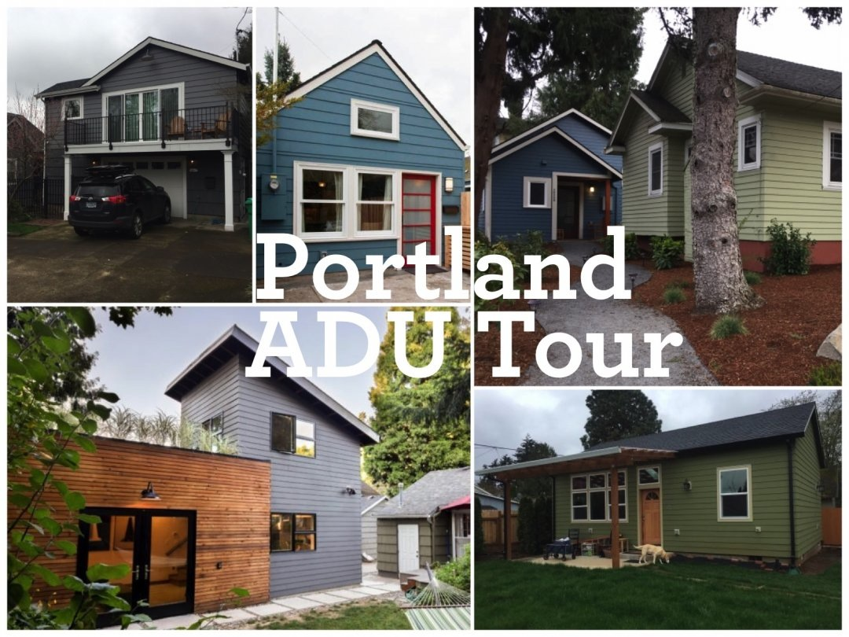
ADUs can become a valued part of the local culture. The Portland ADU tour is conducted via bicycle.

Slide 16
The Best Reason to Allow ADUs?
They’re Cool!
“The Fonz" lived in an ADU above the Cunningham’s garage.
You know you’re at a conference on aging when everybody gets a “Happy Days” reference.
Fonzie would be in his eighties now and Henry Winkler is seventy-two.

