Slide 1
Shared Housing
Denise Lord
Senior Director of Communications and Planning
May 31, 2018

Slide 2
Shared Housing
A new idea?

Slide 4
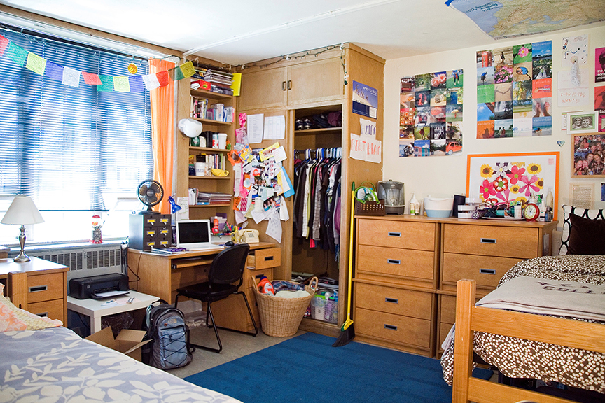

Slide 9
What is Shared Housing
A broad concept that can include:
Home sharing: taking in a room mate
A bed and breakfast
Joint home ownership

Slide 10
Home Sharing
Home Sharing is a simple idea: a homeowner offers accommodation to a home sharer in exchange for an agreed level of support in the form of financial exchange, assistance with household tasks, or both.
National Shared Housing Resource Center

Slide 11
Bed and Breakfast
A homeowner offers accommodation to multiple residents offering a combination of independent space and some shared space.
In this model, a certain level of services may be provided to residents; meals for example.

Slide 12
Intentional Shared Housing
Intentional shared housing involves a legal agreement among residents whereby all have an interest in the home.

Slide 13
What are the benefits of home sharing?
Able to age in place
Companionship, reduced isolation
Provides security and safety
An affordable housing option

Slide 14
The community is also a beneficiary
Shared living makes efficient use of existing housing stock
helps preserve the fabric of the neighborhood
in certain cases, helps to lessen the need for costly chore/care services and long term institutional care.

Slide 15
What are the downsides?
Sharing space with someone new/loss of privacy
Different values and habits
Financial risk
Risk of theft/abuse/exploitation

Slide 16
What should be considered in establishing shared housing?
Are the home sharers interested, open to the idea?
Is it an option in your community?
Check with code enforcement, planning board for potential restrictions
Are there resources available to support the option – transportation for example
Self-managed or is there a program to assist?
Will modifications be required to accommodate housemates?

Slide 17
The Elements of Shared Housing
The relationship(s) and the agreement

Slide 18
Finding the Right House Mate
How does one attract likely candidates? Marketing/Application process
Is this a person to consider?
Screening: Background check and references
Is this the right person?
Interview

Slide 19
What are the conditions of the home share agreement
Compensation/Rent
Check market
Outline expectations – housekeeping, etc.
Put expectations in writing
Trial basis or long term commitment

Slide 20
Managing a Home Share
The relationship between the older adult and housemate will require some maintenance

Slide 21
Managing a home share
Is there someone who can help mediate or manage the relationship if needed?
Stage of life – when is it time for another housing solution?
How does one end the contract?

Slide 22
Shared Housing Programs
Home Sharing programs can offer a more secure alternative to other roommate options. Many programs have staff who are trained to carefully screen each program applicant through interviewing, background checking, and personal references.

Slide 23
Services Offered
Match Search
Introduction
Trial Match
Match Agreement
Ongoing support and mediation

Slide 24
Resources
www.homeshare.org
www.caring.com
www.homesharevermont.org
www.homesharenow.org
www.nationalsharedhousing.org

