Slide 1
Home Accessibility & Safety Modification Programs
Clyde S. Barr
Policy Analyst
May 31, 2018

Slide 2
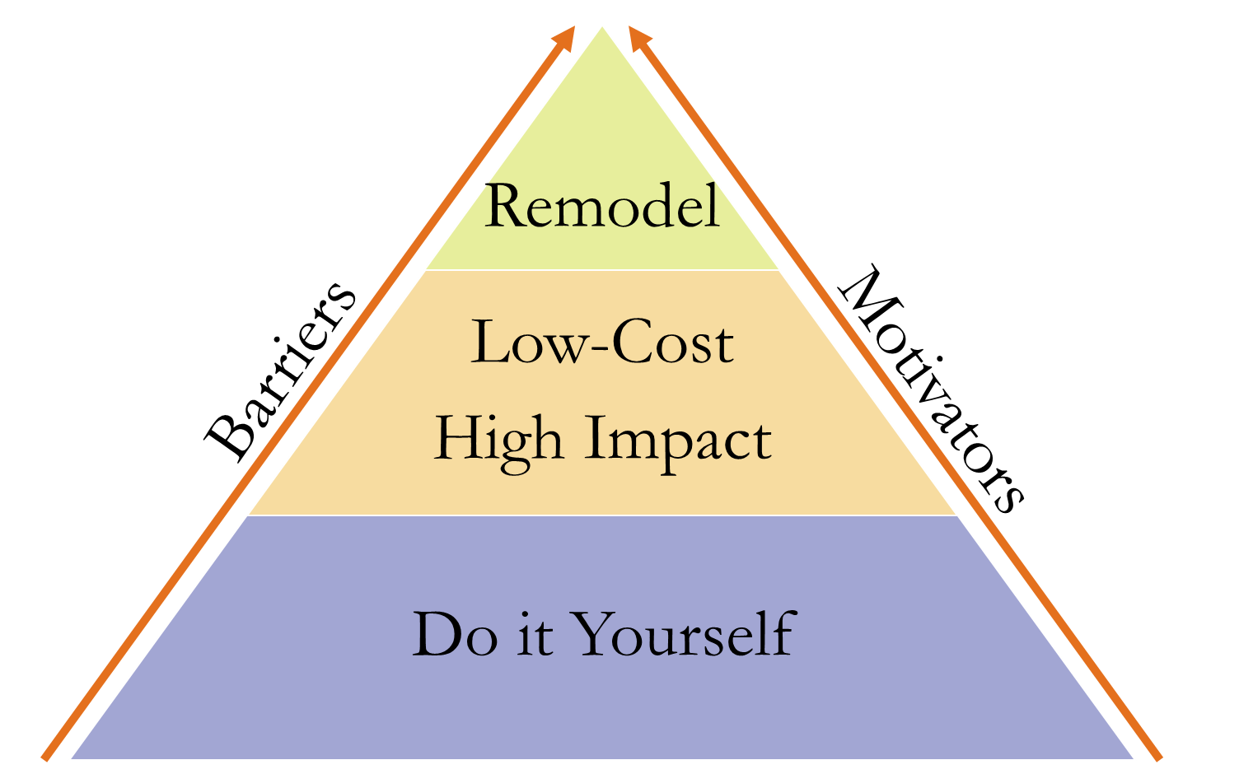
Levels of Home Modifications
Types of Programs
Financial Assistance
Service Providers with Financial Assistance
Private Sector Professionals
Notes:
Financial Assistance
Grants, Loans, & Tax Credits
Service Providers with Financial Assistance
Home modification done by professionals or volunteers funded by government, private foundations, and/or donations
Private Sector Professionals

Slide 3
Notes:
76 UT and Rural towns not mapped due to issues with Census Shape Files – all have 3 or 4 available programs

Slide 4
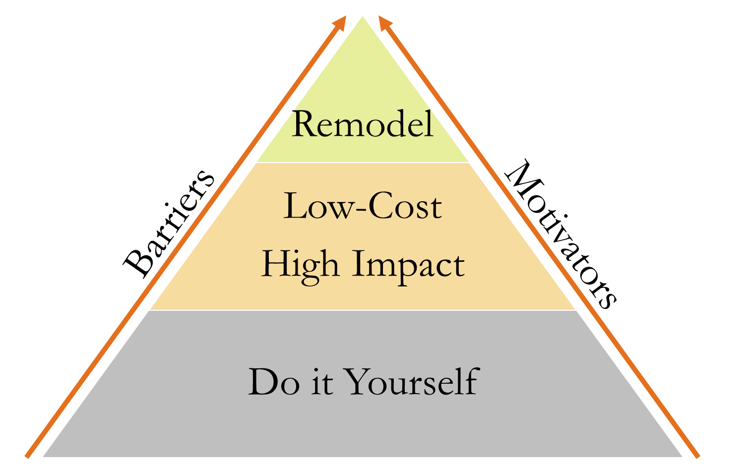
Levels of Home Modifications
Financial Assistance Programs
USDA
  Single Family Housing Repair Loans & Grants
MaineHousing
  AccessAble – Maine income tax credit
Notes:
USDA
Single Family Housing Repair Loans & Grants
Maximum loan: $20,000
Maximum grant: $7,500
Can be combined up to $27,500
Grants must be repaid if the property is sold in less than 3 years
Same process as USDA RD mortgage
MaineHousing
AccessAble – Maine income tax credit up to $9,000
Barriers:
USDA & MaineHousing – homeowner acts as GC
USDA – Lien on property
USDA
What does this program do?
Also known as the Section 504 Home Repair program, this provides loans to very-low-income homeowners to repair, improve or modernize their homes or grants to elderly very-low-income homeowners to remove health and safety hazards.
Who may apply for this program?
To qualify, you must:
Be the homeowner and occupy the house
Be unable to obtain affordable credit elsewhere
Have a family income below 50 percent of the area median income 
For grants, be age 62 or older and not be able to repay a repair loan
What is an eligible area?
Applicants may check the address of their home to determine eligibility.
How may funds be used?
Loans may be used to repair, improve or modernize homes or remove health and safety hazards
Grants must be used to remove health and safety hazards
What are the terms of the loan or grant?
Loans can be repaid over 20 years
Loan interest rate is fixed at 1%
Full title service is required for loans of $7,500 or more
Grants have a lifetime limit of $7,500
If applicants can repay part, but not all of the costs, applicants may be offered a loan and grant combination

Slide 5
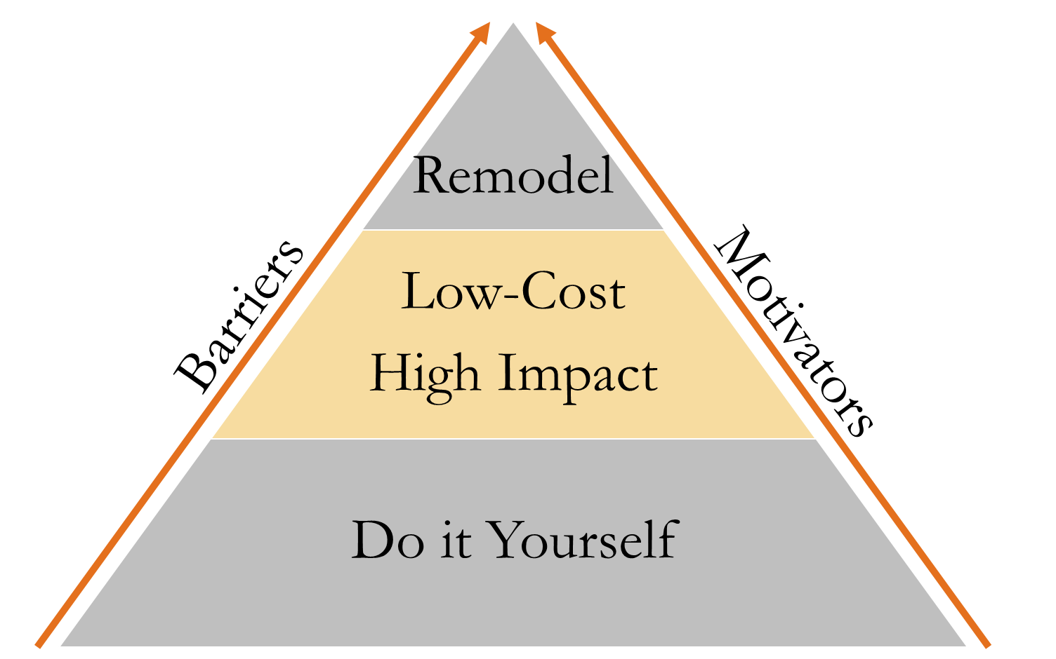
Levels of Home Modifications
Service Providers with Financial Assistance
Habitat for Humanity – Seven Rivers & Greater Bangor
Rebuilding Together – Lewiston & Auburn and Lincoln County
Handy Brigade – Bowdoinham & Richmond
Harpswell Aging at Home
Age Friendly Communities
Notes:
Age friendly communities with a “handy helper” program:
Readfield
Bowdoinham
Cumberland
Bethel Age-Friendly Community Initiative (includes Greenwood, Newry, Woodstock, Gilead, Hanover and Bethel)
Saco

Slide 6
Levels of Home Modifications
Service Providers with Financial Assistance
MaineHousing programs
Home Accessibility and Repair Program
Comfortably Home
Notes:
MaineHousing programs
Home Accessibility and Repair Program
Administered by Community Action Agencies
Comfortably Home
Administered by 6 local Public Housing Authorities

Slide 7
MH Program | HH Served
AccessAble | 11
Comfortably Home | 115
Home Accessibility & Repair Program | 76
Total | 202
Notes:
Home Accessibility & Repair Program – 119 total households served, 76 were age 62+
Elderly categorical projects- 26
HR projects serving elderly- 27
Emergency projects serving elderly- 21
Drought projects serving elderly- 2
Total projects serving elderly- 76

Slide 8
MaineHousing Complementary Programs
Pre-1976 Mobile Home Replacement Initiative
Weatherization
Central Heating Improvement Program

Slide 9
Clyde S. Barr
Policy Analyst
207.624.5772
cbarr@mainehousing.org

